Slide 1
Cursive Script of Chinese Calligraphy
Presented by XinYuan Hu

Slide 2
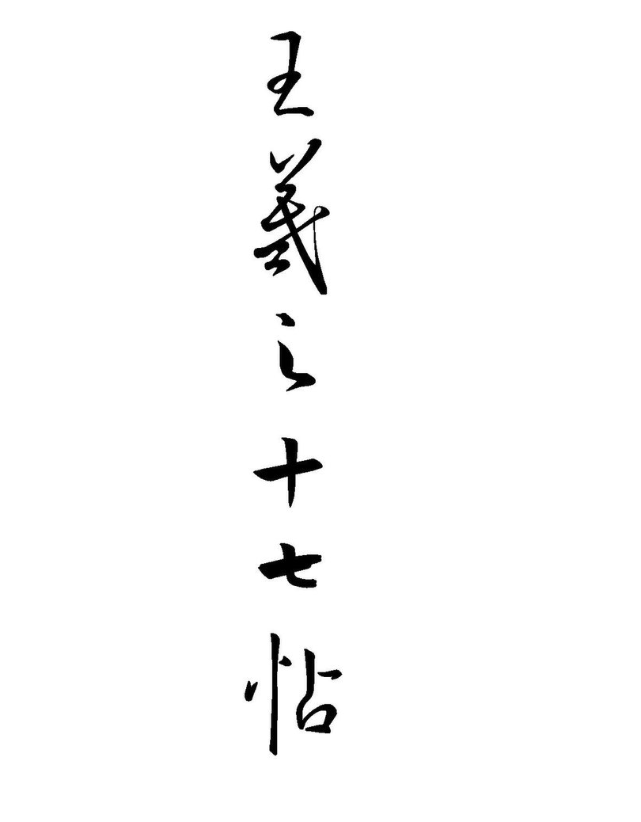
Wang Xizhi's Seventeenth Exemplar
十七帖 (seventeen exemplar) is a cursive calligraphic masterpiece written by Wang Xizhi (303–361). The original was lost but it was replicated many times over the centuries by stone carving and stone rubbing. Most of the surviving replicas are severely damaged.

Slide 3
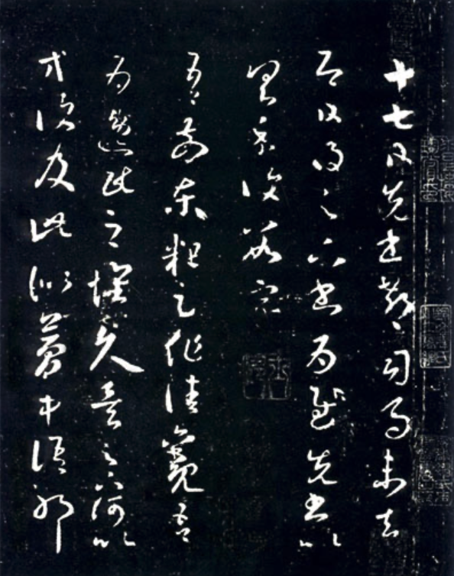
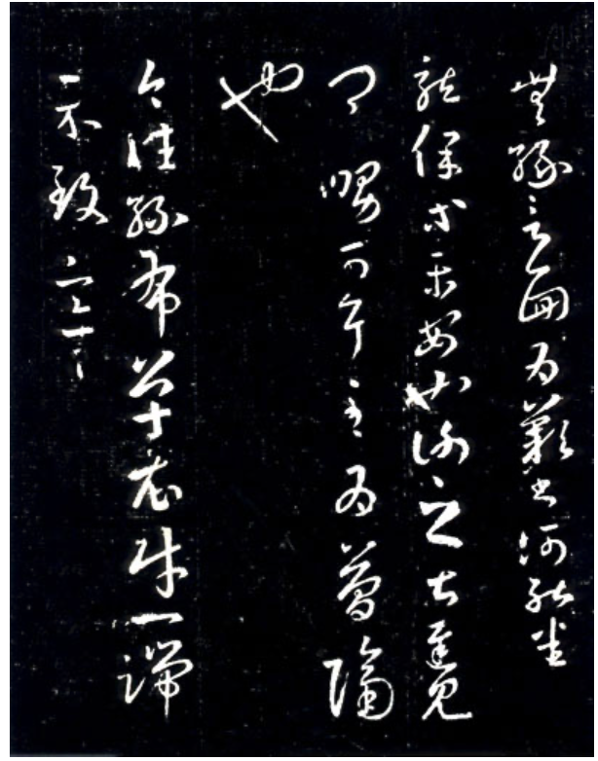
Appreciation of his seventeenth exemplar
On the 17th, the letter was written and I wanted to ask Chi Sima to take it with me. But before I set off, I received your letter on the same day. I was very pleased. What I want to say has been written in the previous letter, so I will only write a few words here as a reply.
"During my last journey to the east, I caught a glimpse of the beautiful landscapes of that time. I have been contemplating the idea of leading a reclusive life for a long time. Why do you repeatedly bring up the matter of returning to official service ? It feels like dream words. Unfortunately, we haven't had the chance to meet in person, which I deeply regret. In letters, it is challenging to fully express my feelings."

Slide 4
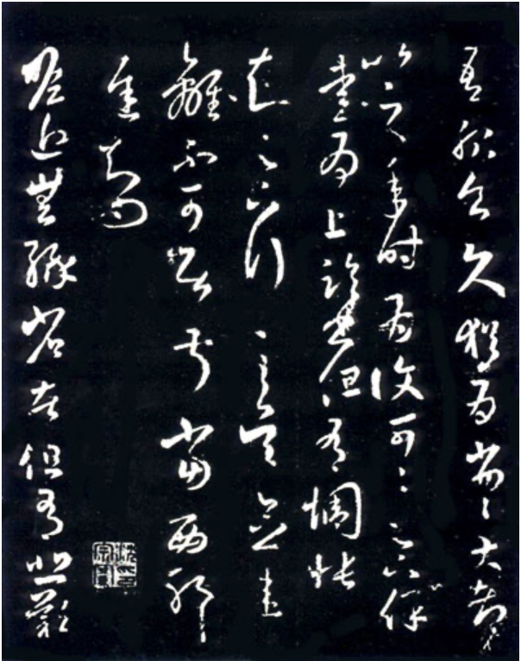
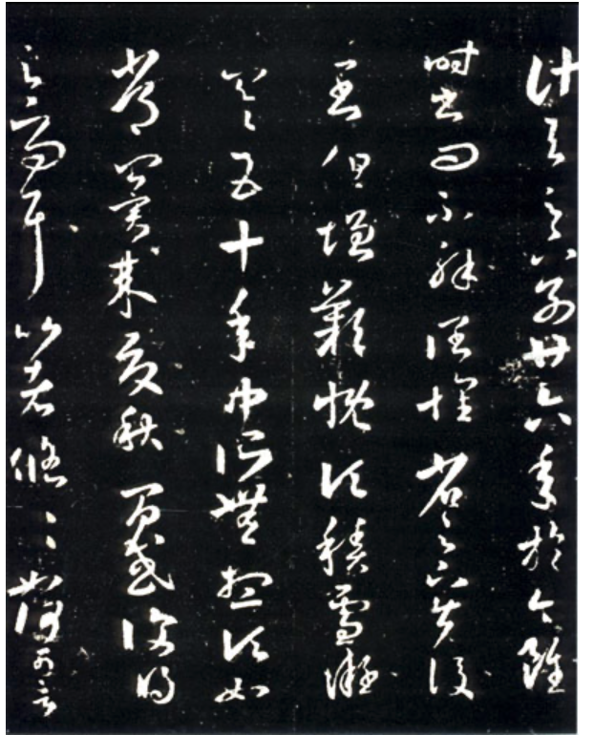
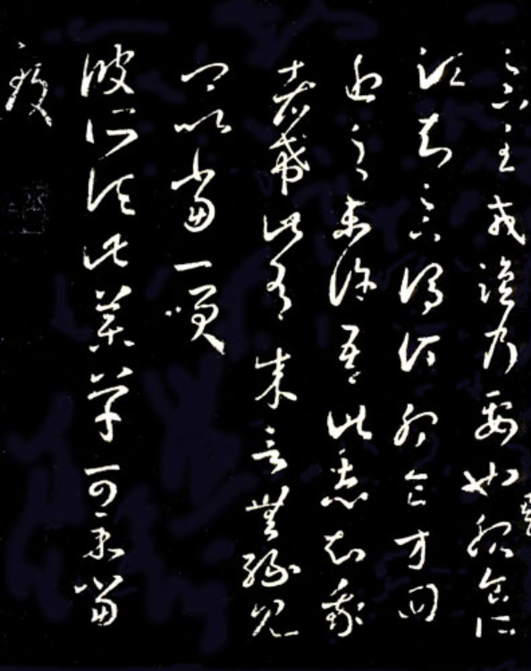

Slide 5
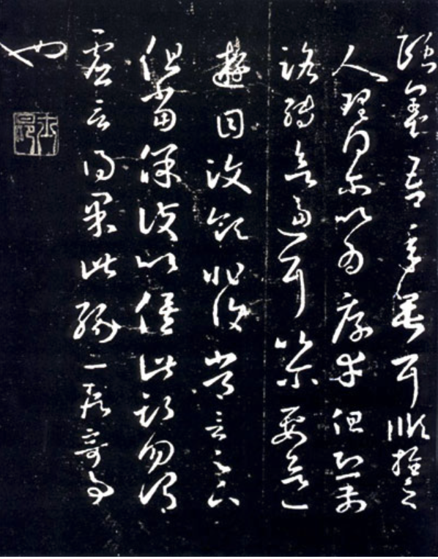
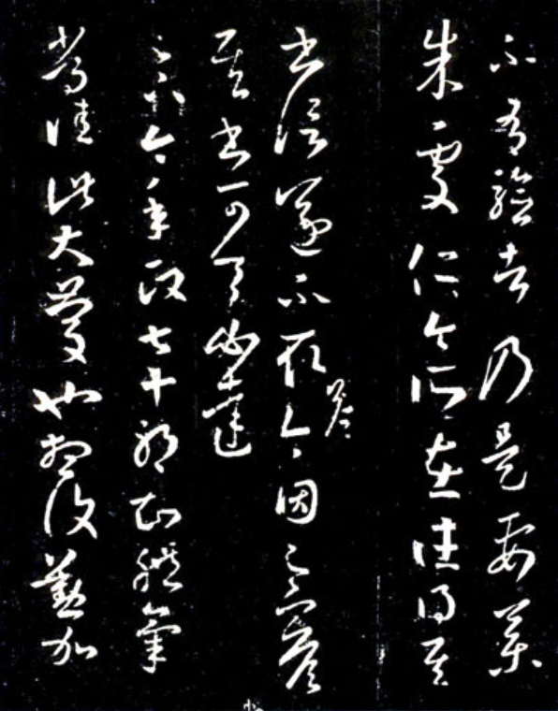
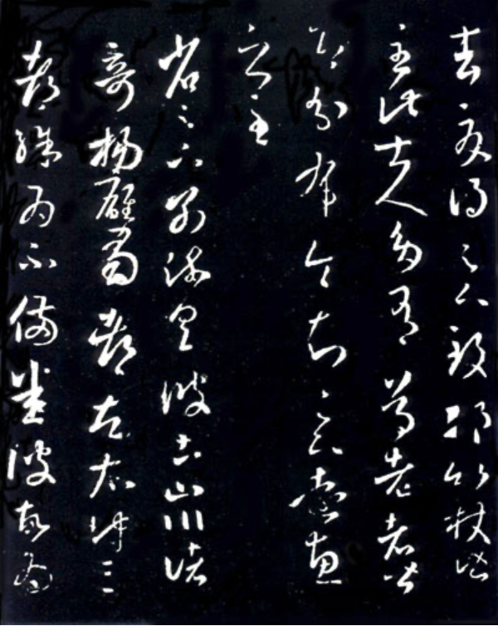

Slide 6
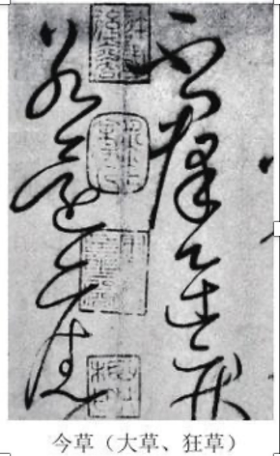
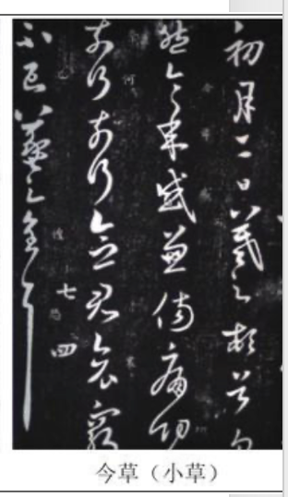
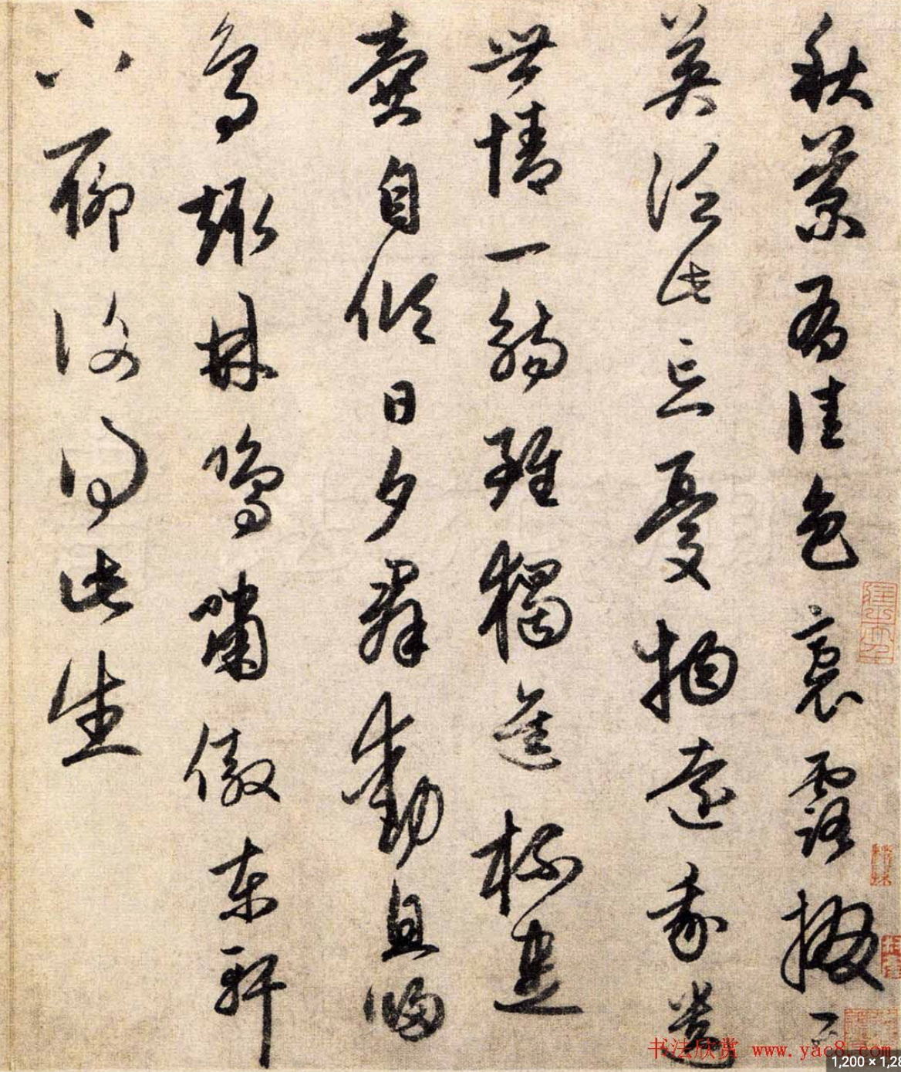
Types of cursives
章草（zhangcao）：It evolved directly from official script, originated in the Western Han Dynasty, and matured in the Eastern Han Dynasty.
行草（xingshu）：A calligraphy style between running script and cursive script. The handwriting is easier to read without losing the dynamic feeling of cursive script.
今草（jincao）：Also known as “tiny cursive". It is said that it originated from Zhang Zhi's championship post in the late Eastern Han Dynasty and evolved from Zhang Cao. After the Eastern Jin Dynasty, it gradually matured.

Slide 7
Evolution of Cursive Script
By the Tang Dynasty, cursive script had become an art of calligraphy and therefore evolved into "crazy cursive script". Its function as a tool for transmitting information has been weakened and it has become a work of art. It pays attention to the black and white arrangement of shelves and paper, and whether people can clearly understand what is written. It's no longer important.

Slide 8
Tang Dynasty Cursive Script Appreciation
Zhang Xu and Huai Su were two masters of cursive script in the Tang Dynasty. Together they were models of the cursive script in the Tang Dynasty and reached the pinnacle of that era.
Both of these people have some forms of madness and craziness, that is, they like to write after drinking. In the Tang and Song dynasties, there was a tradition "writing on the wall", that is, after being dazzled, they would write poems on the wall. Such works often lasted for a long time. Their arts achieve a high degree of unity between calligraphy beauty, natural beauty and emotional beauty.

Slide 9
圣母帖（sheng mu tie） by 怀素（huai su）

Slide 10
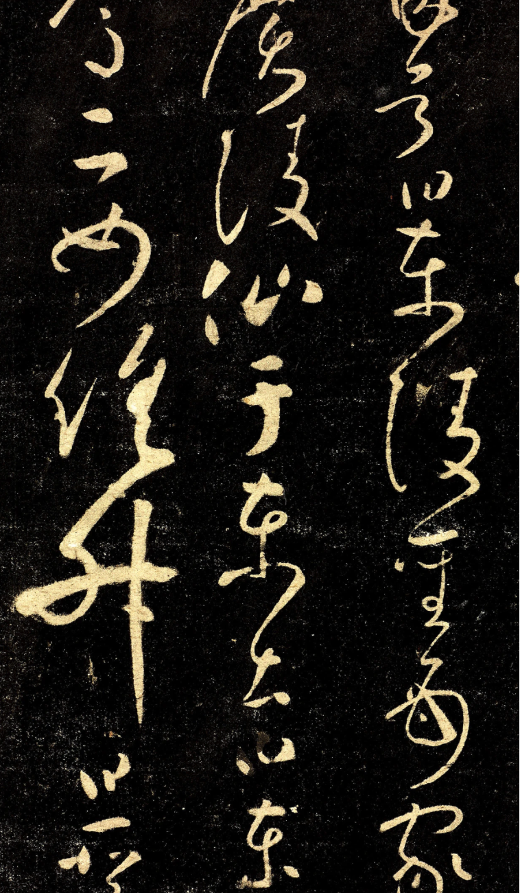
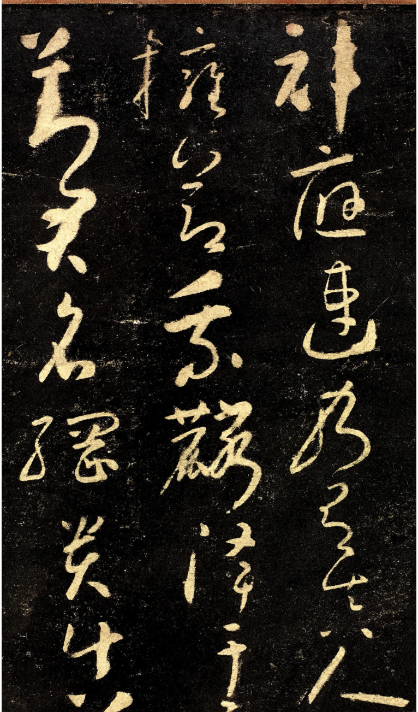
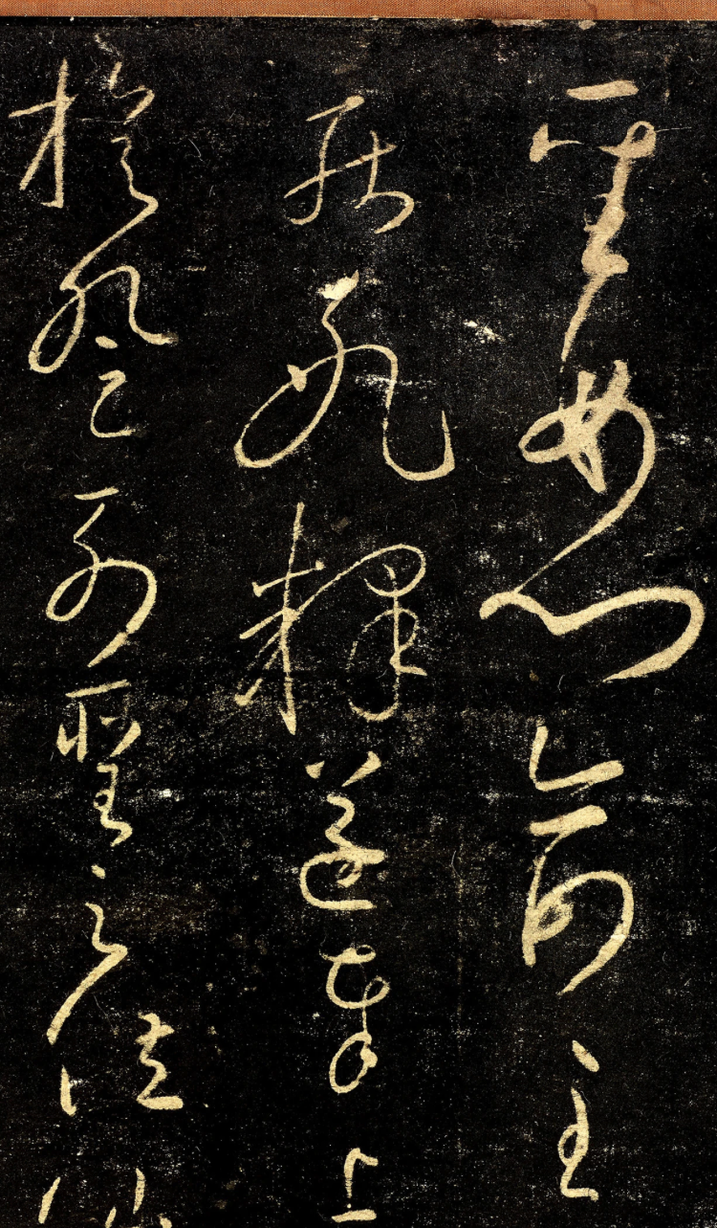
Notes:
后来怀素去洛阳拜访了颜真卿，颜真卿将自己从张旭那里学到的《述张长史笔法十二意》全部传授给了怀素。在他40岁的时候，他写下了“天下第一草书”——《自叙帖》，这件草书作品完完全全是怀素个人的一个展现

