Slide 1
Decline of the Western Jin
Mike Chu

Slide 2
End of the Han Dynasty and Three Kingdoms Period (184-263 CE)
Yellow Turban Uprising
184 CE
Rebellion fails, but problems accumulated within empire become evident and unrepairable
Three Kingdoms Period
Wei (曹魏), Shu (蜀漢), Wu (吳)

Slide 3
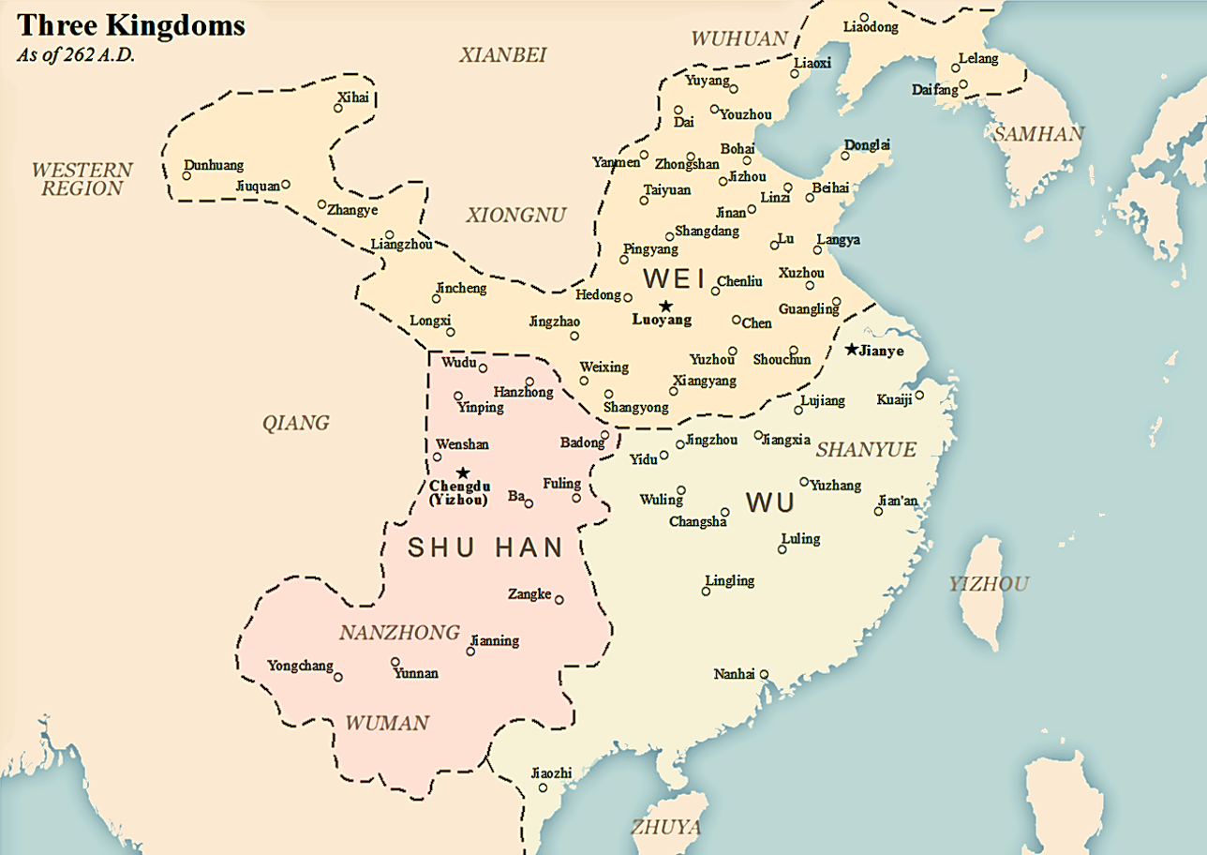
Map of The Three Kingdoms

Slide 4
Beginning of The Western Jin Dynasty
Incident at Gaoping Tombs (249 CE)
Sima Yi stages a coup d’etat
Transfers all real authority to the Sima clan
Founding of the Jin Dynasty
266 CE
Sima Yan (Sima Yi’s grandson) forces the Wei emperor to abdicate
Conquest of Shu
263 CE
Conquest of Wu
280 CE

Slide 5
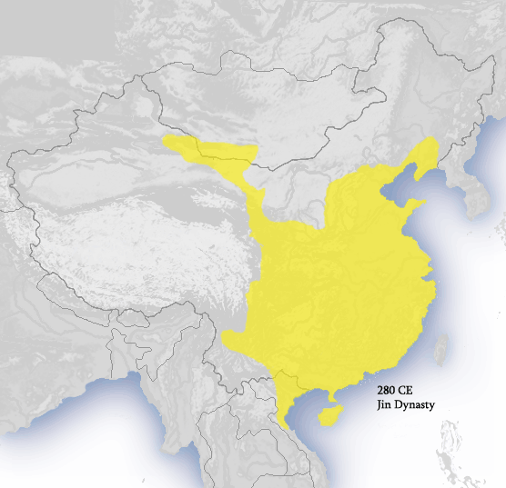
Jin Dynasty Map

Slide 6
Decline of Western Jin
Sima Yan’s death leaves power vacuum
New Emperor Sima Zhong inept
Imperial family member Yang Jun appointed as sole reagent (originally intended to be co-reagent with Sima Liang)
Empress Jia Nanfeng seizes power
Persuades Sima Liang and Sima Wei to kill Yang Jun
Eliminates Sima Liang and Sima Wei due to lack of cooperation

Slide 7
The War of Eight Princes (八王之亂)
291-306 CE
Empress Jia Nanfeng is overthrown by Sima Lun
Power vacuum culminates in massive in-fighting amongst the imperial family
Sima Liang
Sima Wei
Sima Lun
Sima Jiong
Sima Ai
Sima Ying
Sima Yong
Sima Yue

Slide 8
Result
Sima Yue emerges victorious and makes himself Chancellor (丞相)
Devastated the power of the imperial family and central authority
Many deaths beyond the eight princes
Killed off many ministers, magistrates, etc. from purges and executions
Decreased loyalty to the imperial dynasty
Disaster of Yongjia

Slide 9
Disaster of Yongjia (永嘉之亂)
Han people and Nomadic tribes
Continuous conflict throughout Chinese history
Heqin policy in early Han dynasty
Conflict during Three Kingdoms Period (Gonsun Zan, Mao Chao, Dong Zhuo, etc.)
Xiongnu Invasion (308 CE)
Xiongnu tribe led by Liu Cong invades into central China
Sima Yue dies while on campaign to oppose them
Siege and burning of Luoyang
Many imperial authorities killed while fleeing
Expected help from local provinces did not arrive

Slide 10
End of Western Jin and Beginning of the Sixteen Kingdoms
In 316 CE, the Emperor of Jin surrenders to the Xiongnu
Initially arrested, but eventually put to death
Some members of the imperial family are allowed to live
Jin Kingdom relocates to Southern China
For the first time in Chinese history, the Han people are pushed out of Central China
Begins the Sixteen Kingdoms Era

Slide 11
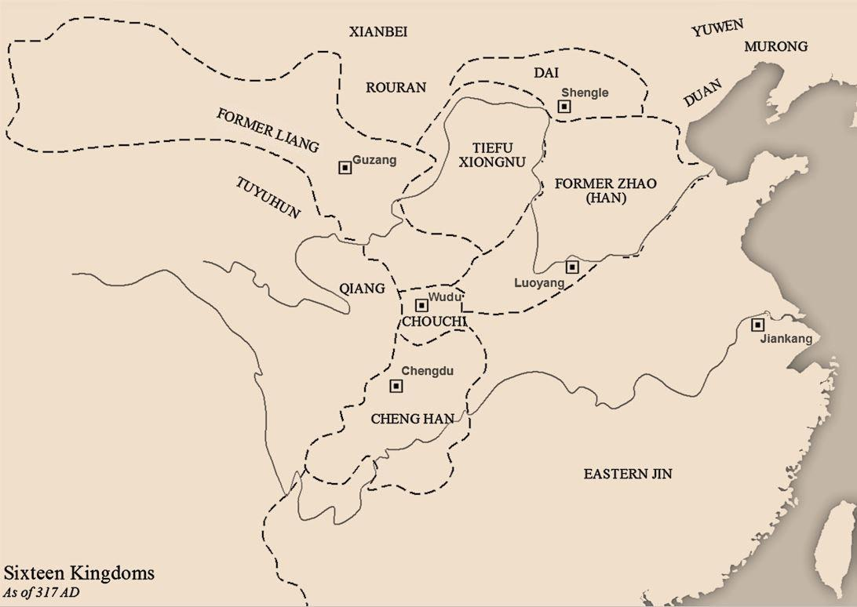

Slide 12
擧世混濁
When the world is in Chaos
淸士乃見
The honest scholar appears
-Records of the Grand Historian (Biography of Boyi and Shuqi)

Slide 13
Image Citations
The Territories of Wu (In Light Greenish Grey), As of 262 A.D. (2017, August 11). Wikipedia. https://upload.wikimedia.org/wikipedia/commons/thumb/7/7b/Three_Kingdoms.png/1280px-Three_Kingdoms.png
Kiu, I. (2008, March 14). The jin dynasty (yellow) at its greatest extent, c. 280, during the western jin dynasty. Wikipedia. https://upload.wikimedia.org/wikipedia/commons/9/9e/Western_Jeun_Dynasty_280_CE.png
Map of Sixteen Kingdoms as of 317 AD. (2017, September 29). Wikipedia. https://upload.wikimedia.org/wikipedia/commons/d/d3/Sixteen_Kingdoms_317_AD.jpg

