Slide 1
Khmer Script/Calligraphy
Evan Hanley

Slide 2
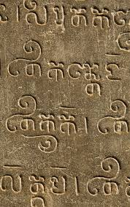
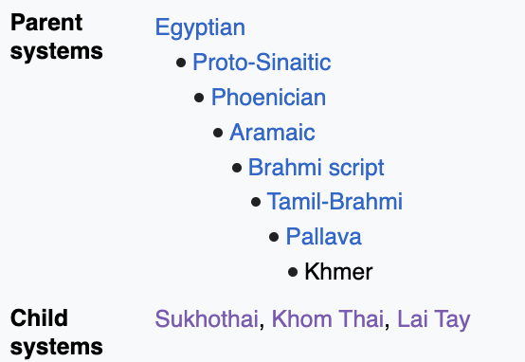
History of Khmer Script
Official script of the Khmer language, used in current-day Cambodia.
Heavily influenced from the Brahmic Scripts of India, and its first dated inscription within Cambodia dates back to the 5th century AD.
Similar to scripts of the Indian subcontinent, it is an abugida (alphasyllabary) script
Worlds longest alphabet, with 74 letters in total.

Slide 3
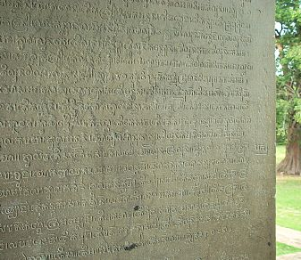
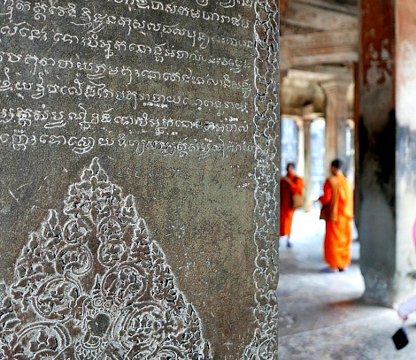
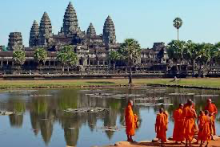
Khmer Stone Steeles/Tablets
Often oldest examples of the Khmer language perserved through religious texts on stone steeles.
Written in Old Khmer （used primarily from 5-13th centuries)
Scattered throughout Cambodia, but most found in and around Angkor Wat temple complex.

Slide 4
Variants of Modern Khmer Script
Several styles of Khmer Script are used for varying purposes. The two main styles are âksâr chriĕng (literally "slanted script") and âksâr mul ("round script").
Âksâr chriĕng refers to oblique letters. Entire bodies of text such as novels and other publications may be produced in âksâr chriĕng. Handwritten Khmer is often written in the oblique style.
Âksâr mul is the calligarphical style often seen in Khmer script. It is used for titles and headings in Cambodian documents, on books, banknotes, shop signs and banners.

Slide 5
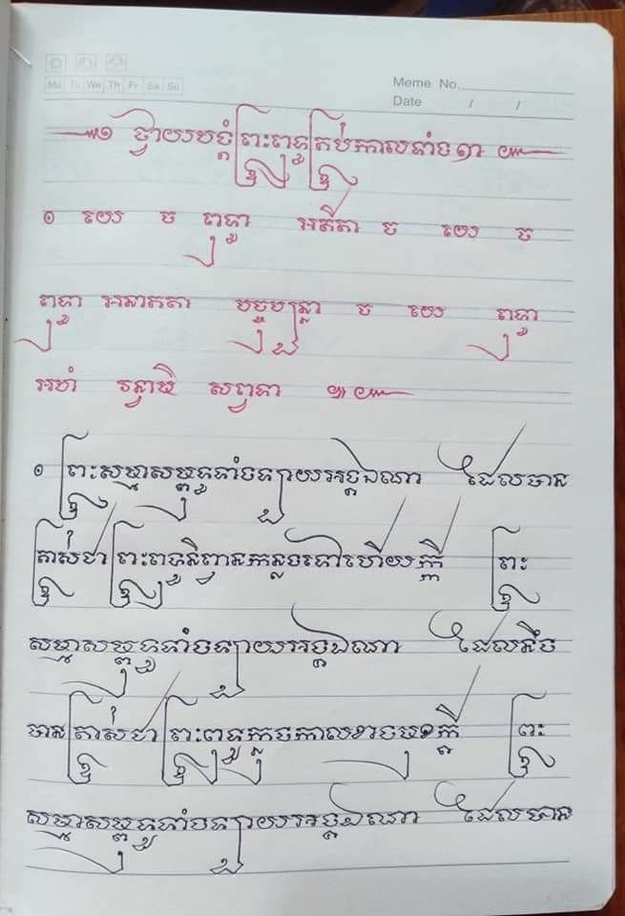
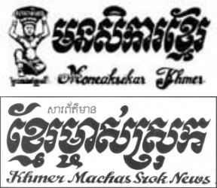

Slide 6
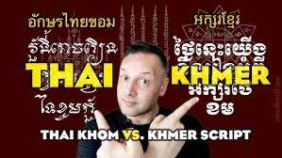
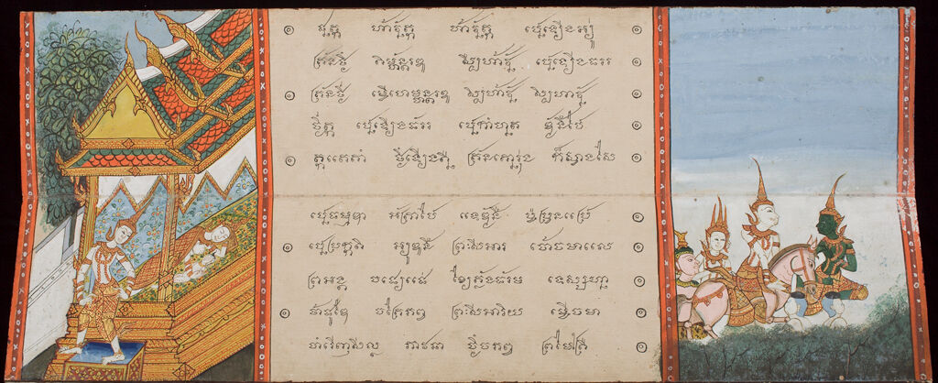
Thai-Khom Script: Connection between Cambodia and Thailand
Thai-Khom, literally Thai-Khmer script
Between the 12 and 14th centuries, the Thai added additional letterforms and letters to the Old-Khmer script, to be able to write the Thai language. They called this new version of the Khmer script "Khom", which means "Khmer" in Thai.
The Khom Thai script was the most widely used of the ancient scripts found in Thailand.

Slide 7
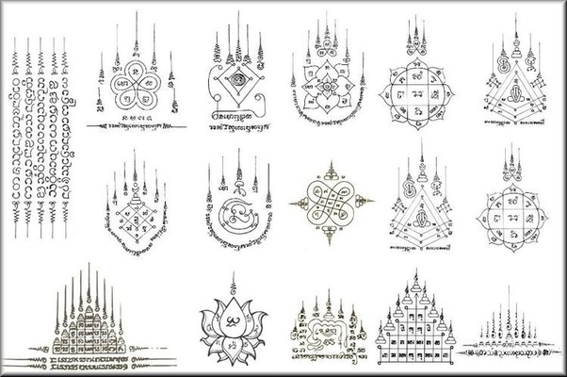
Khmer Script and Sak Yant: Khmer traditional tattoos
Sak Yant is a form of tattooing that originated in Mainland Southeast Asia and practiced throughout Cambodia. It incorporates Buddhist prayers, ancient symbols, and sacred geometry.
Sak Yant tattoos are believed to offer protection, good luck, and other spiritual benefits to the wearer.

Slide 8
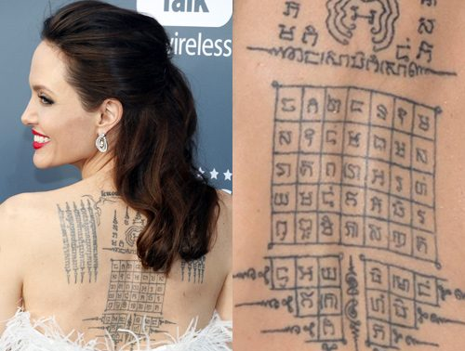

Slide 9
Sources/Images
https://www.omniglot.com/writing/khmer.htm
https://openbooks.lib.msu.edu/basickhmer/front-matter/introducation/

