Slide 1
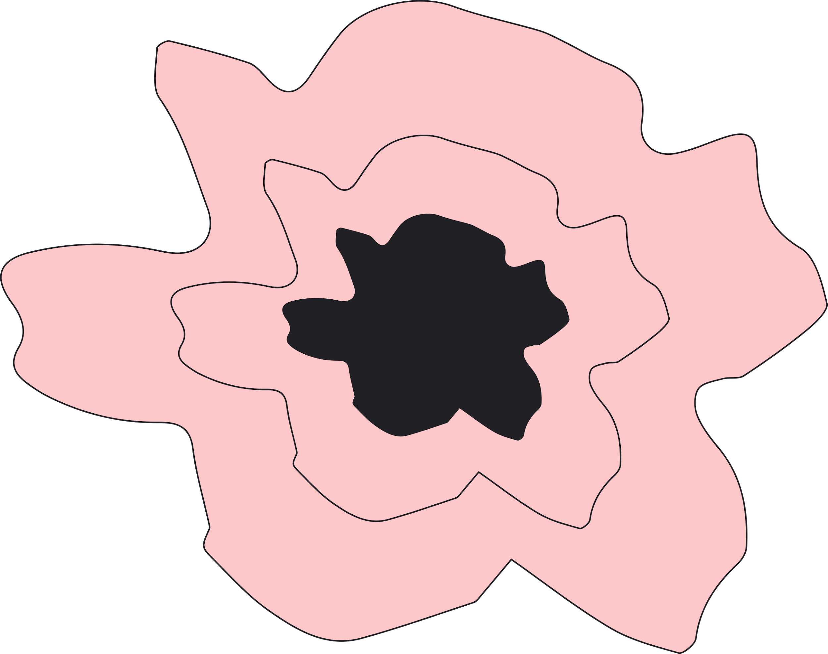
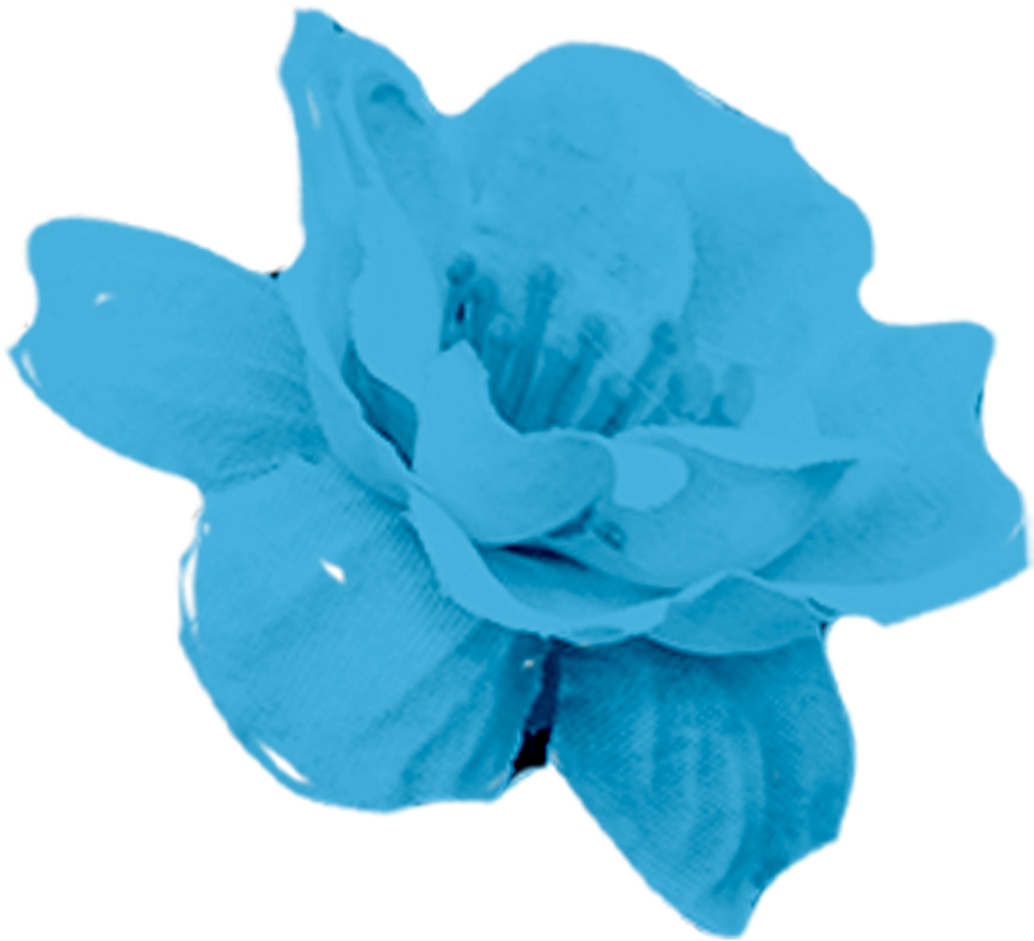
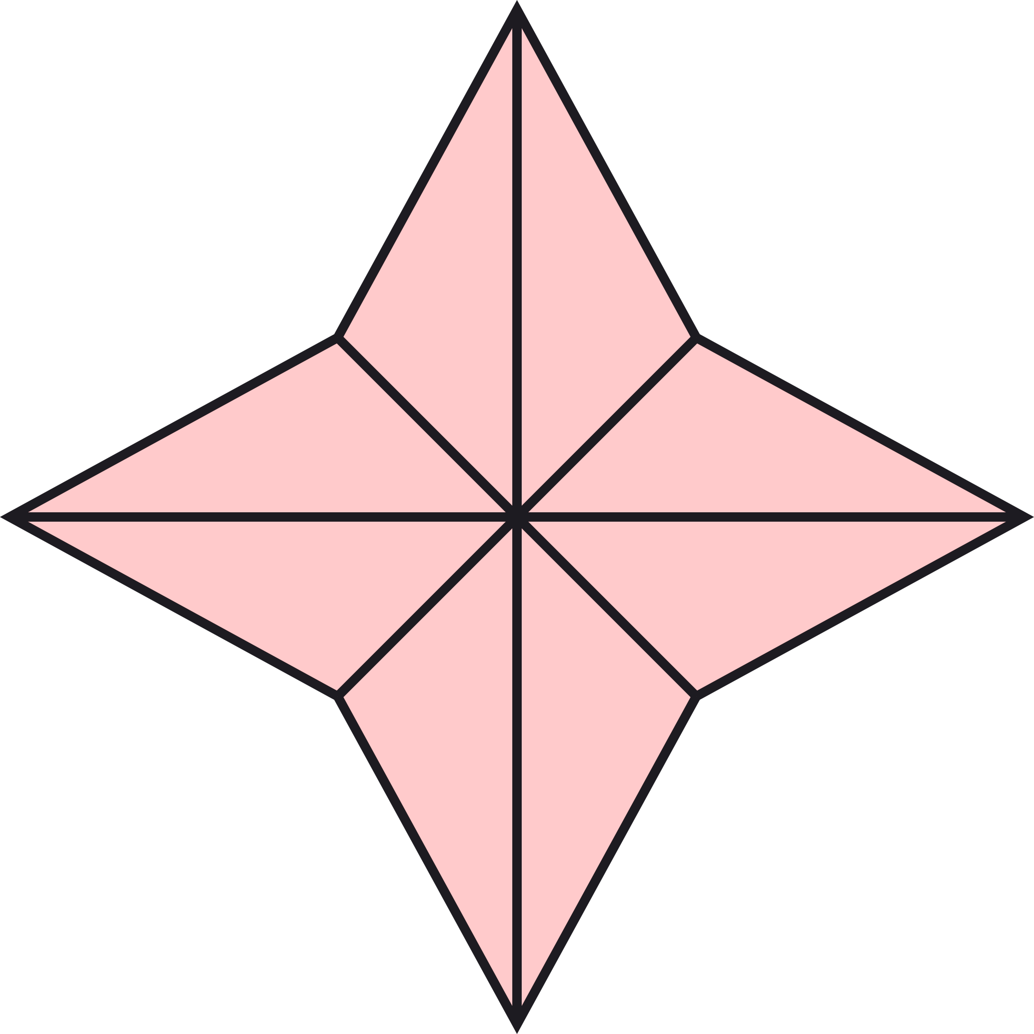
Famous Calligraphy
Pieces
Ava Seccuro

Slide 2
Agenda
Chinese Calligraphy
Japanese Calligraphy
Korean Calligraphy

Slide 3
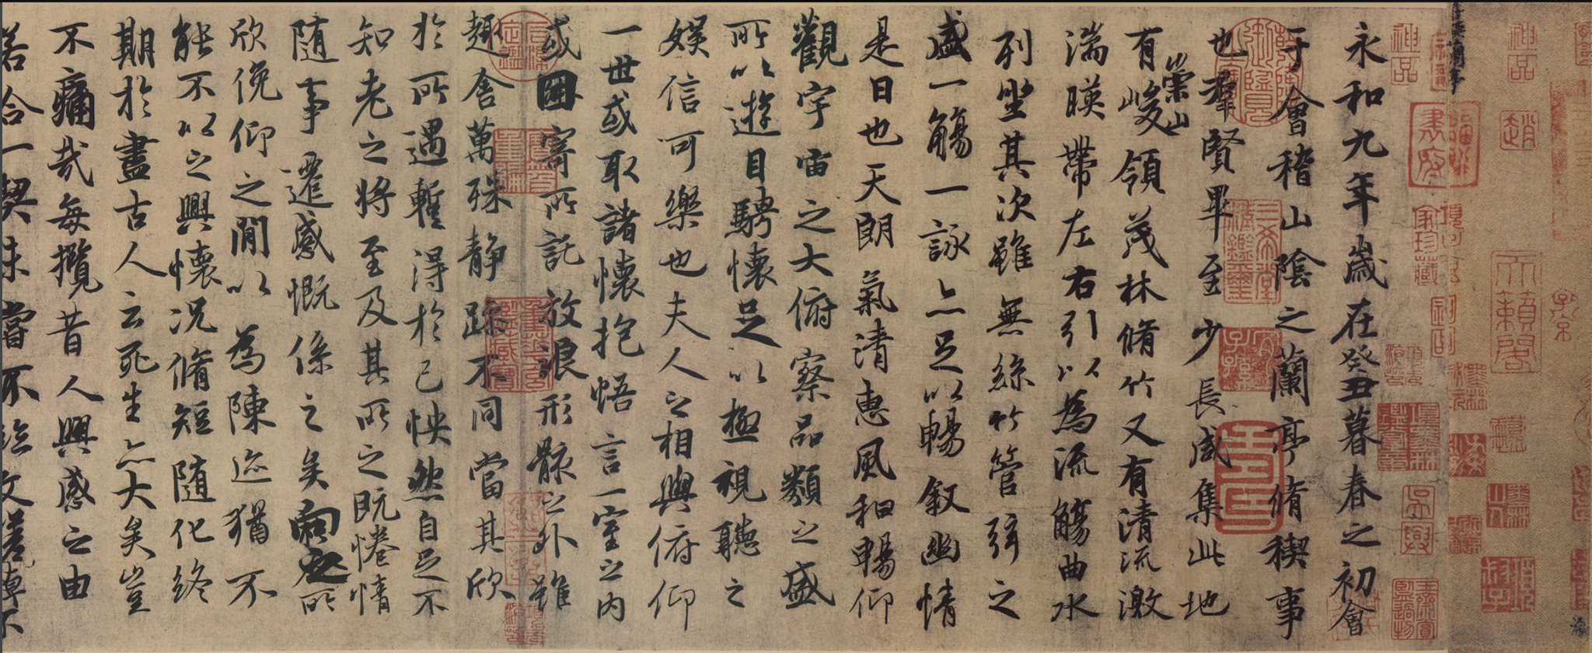
Orchid Pavilion
Spring Purification Ceremony: cups of wine were floated on the water downstream, and whenever a cup stopped in front of a guest, he had to compose a poem or otherwise drink the wine
Emperor Taizong of Tang (唐太宗, 598–649) was so fond of this piece that he had it buried with him
Marked by sentimental lines which lamented the swiftness and uncertainty of life
Written in the running (or semi-cursive) style on a cocoon paper with a weasel-whisker brush. It consists of 324 characters in 28 columns.
Improvisational style: The character Zhi (“之”) also appeared 20 times but was never written the same way.
Notes:
Context: Spring Purification Ceremony: During the event, forty-two literati gathered along the banks of a coursing stream and engaged in a "winding stream" drinking contest: cups of wine were floated on the water downstream, and whenever a cup stopped in front of a guest, he had to compose a poem or otherwise drink the wine

Slide 4
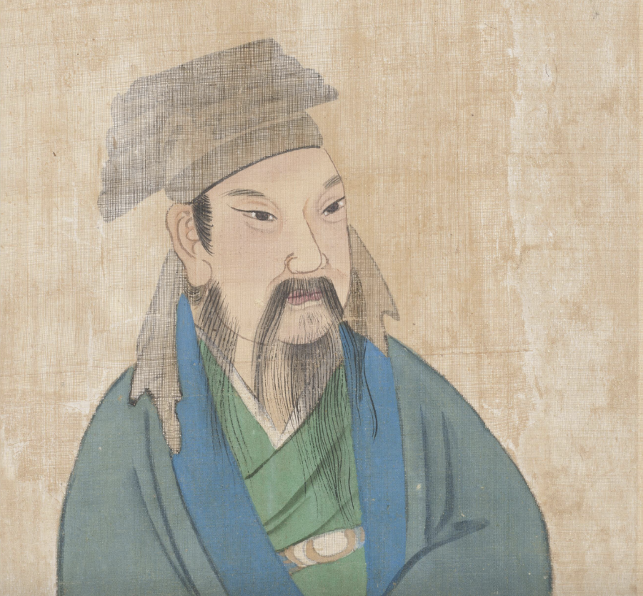
Artist Profile
Wang Xi Zhi
Most famous calligrapher of his time
Particularly remembered for one of his hobbies, that of rearing geese. Legend has it that he learned that the key to how to turn his wrist whilst writing was to observe how geese moved their necks.

Slide 5
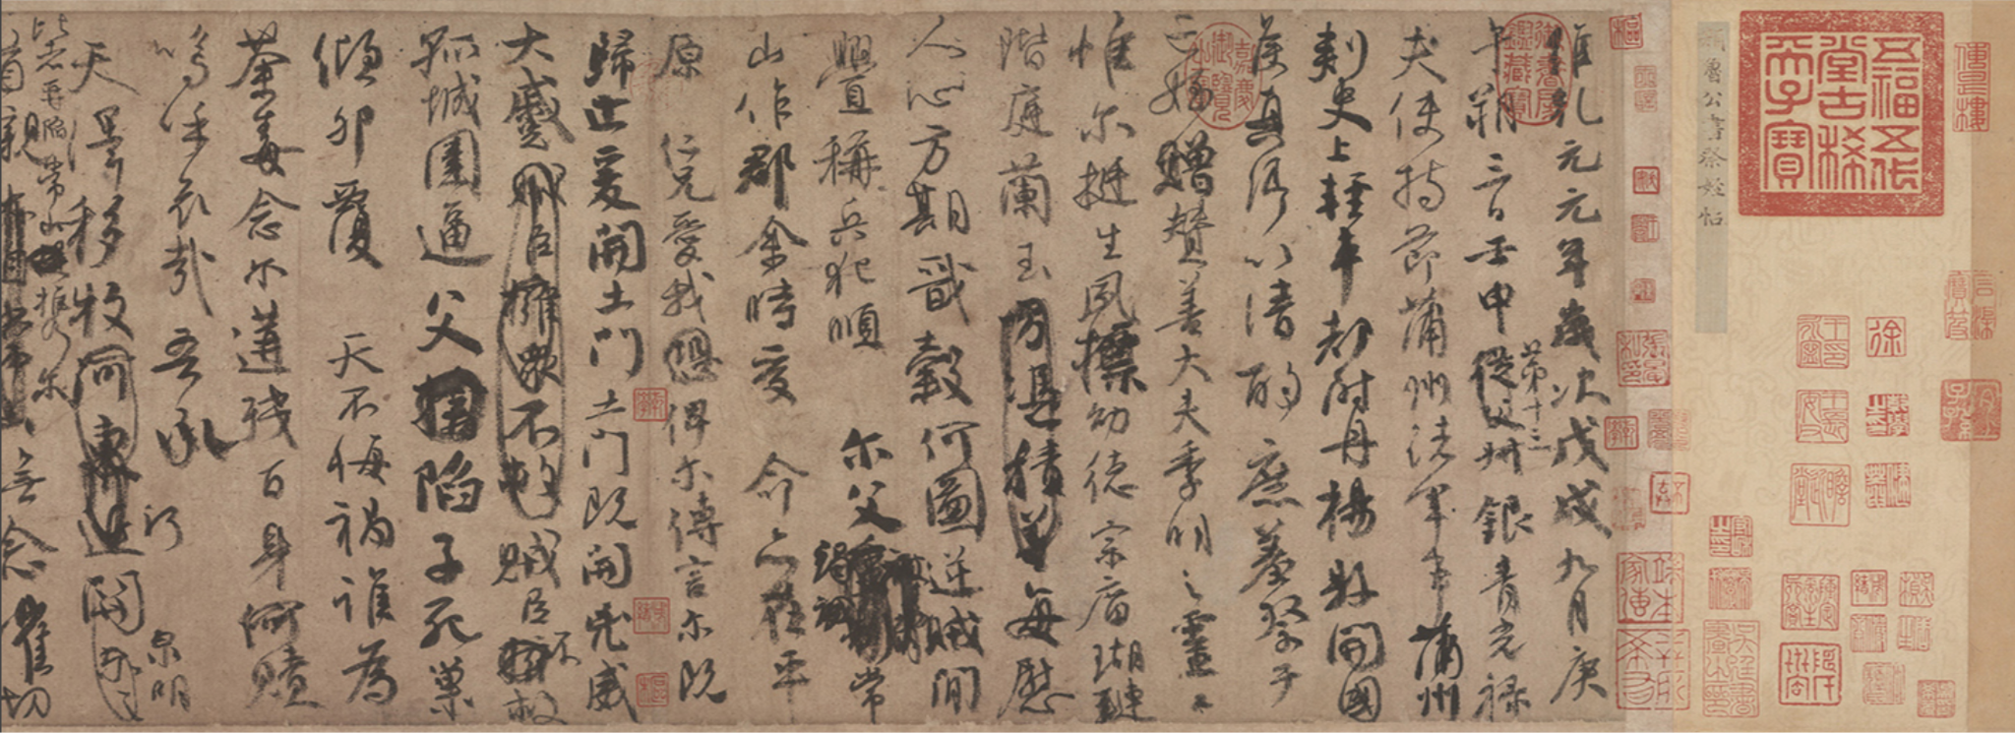
Requiem to my Nephew
Yan Zhenqing was a man of loyalty and integrity all his life, and this spirit is revealed in his calligraphy
Done with a stubby brush, Yan imparted a round and upright manner to the strokes. There is considerable variety to the ink tones from start to finish, due to the speed and movement of the brush
Likely a more formal piece
went back and crossed out and changed characters in numerous places. This shows how he composed and edited his writing, providing insight into his ideas as well as his calligraphy

Slide 6
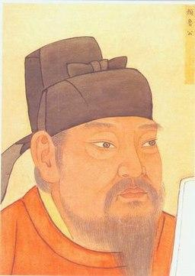
Artist Profile
Yan Zhenqing
Ancestors came from Linyi (臨沂) in Shandong (山東).
During the revolt of Li Xilie (李西烈), Yan Zhenqing was instructed to bring an imperial communique to the rebels.
He was detained and executed.
Considered a loyal martyr of the Tang dynasty.

Slide 7
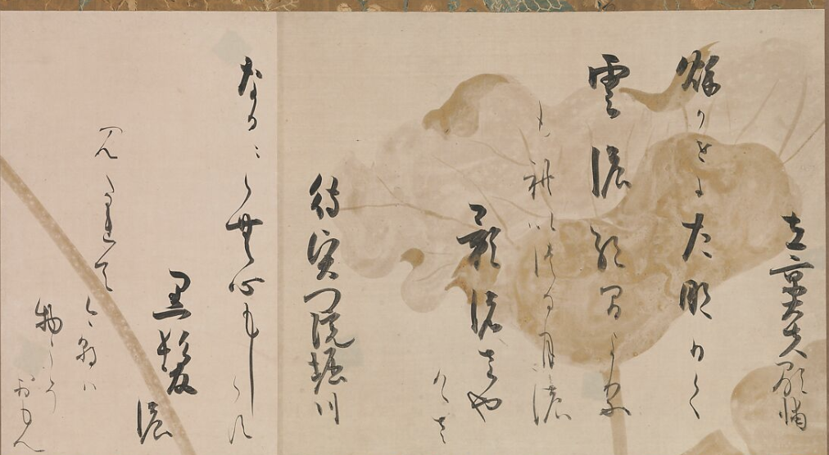
“100 poets Anthology”
Edo period, Hon’ami Kōetsu
Had paper made to order and painted a backdrop of decorative patterns, butterflies or floral elements that his calligraphy established a poetic correspondence with
The underpainting in gold and silver by Tawaraya Sōtatsu describes the life cycle of the lotus—a plant associated with Buddhism.

Slide 8
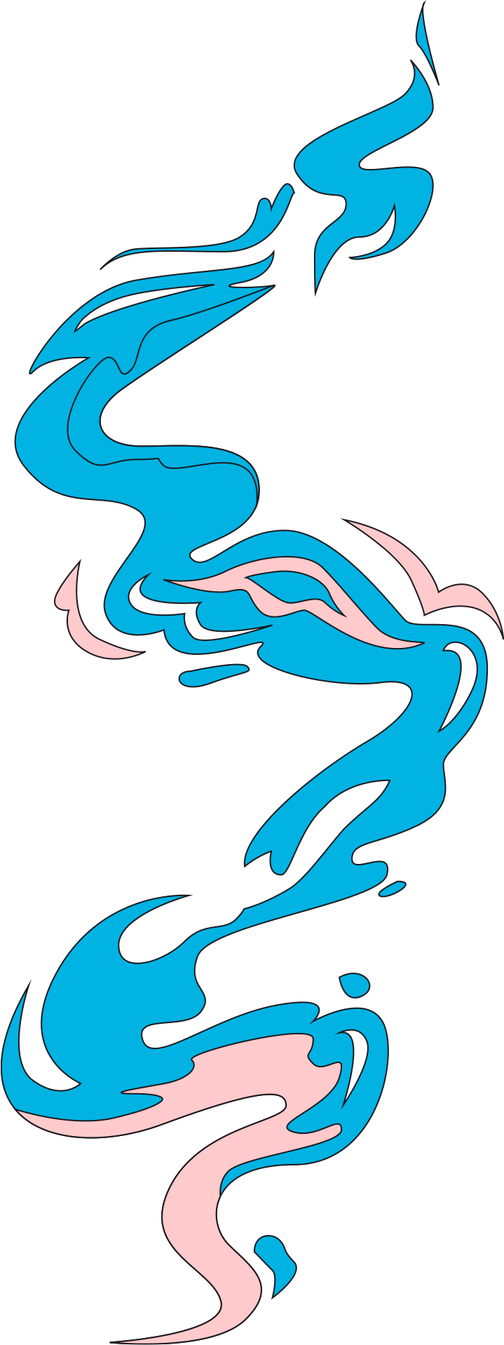
Zen Buddhism
Japanese calligraphy was influenced by, and influenced, Zen thought.
For any particular piece of paper, the calligrapher has but one chance to create with the brush.
The brush strokes cannot be corrected, and even a lack of confidence shows up in the work.
The calligrapher must concentrate and be fluid in execution.
To write Zen calligraphy with mastery, one must clear one's mind and let the letters flow out of themselves, not practice and make a tremendous effort. This state of mind was called the mushin (無心, "no mind state") by the Japanese philosopher Nishida Kitaro

Slide 9
Exhibit 1
By Kim Jeonghui (1786-1856) (pen name Chusa), the most renowned calligrapher from the Joseon period.
He developed his own hangul script by taking elements of seal script (Jeonseo) and clerical script (Yeseo) originally used for Chinese characters
His style was criticised for being too artistic and too removed from the established masters of calligraphy

Slide 10
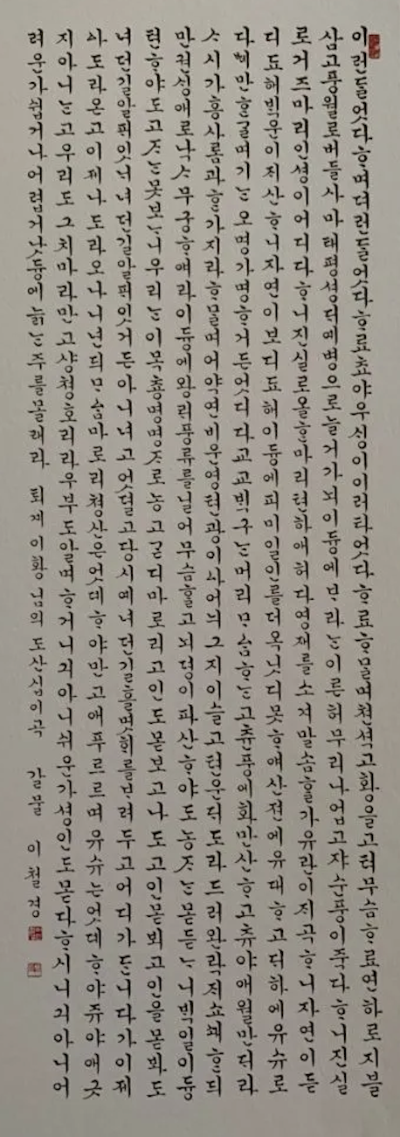
Exhibit 2
Lee Cheol Gyeong, pen name Galmul, one of the few female calligraphers
She is famous for developing her own style of hangul palace script (gungche) called Galmul after her pen name
Artist born into an aristocratic family because calligraphy in Korea was a sign of status and wealth

