Slide 1
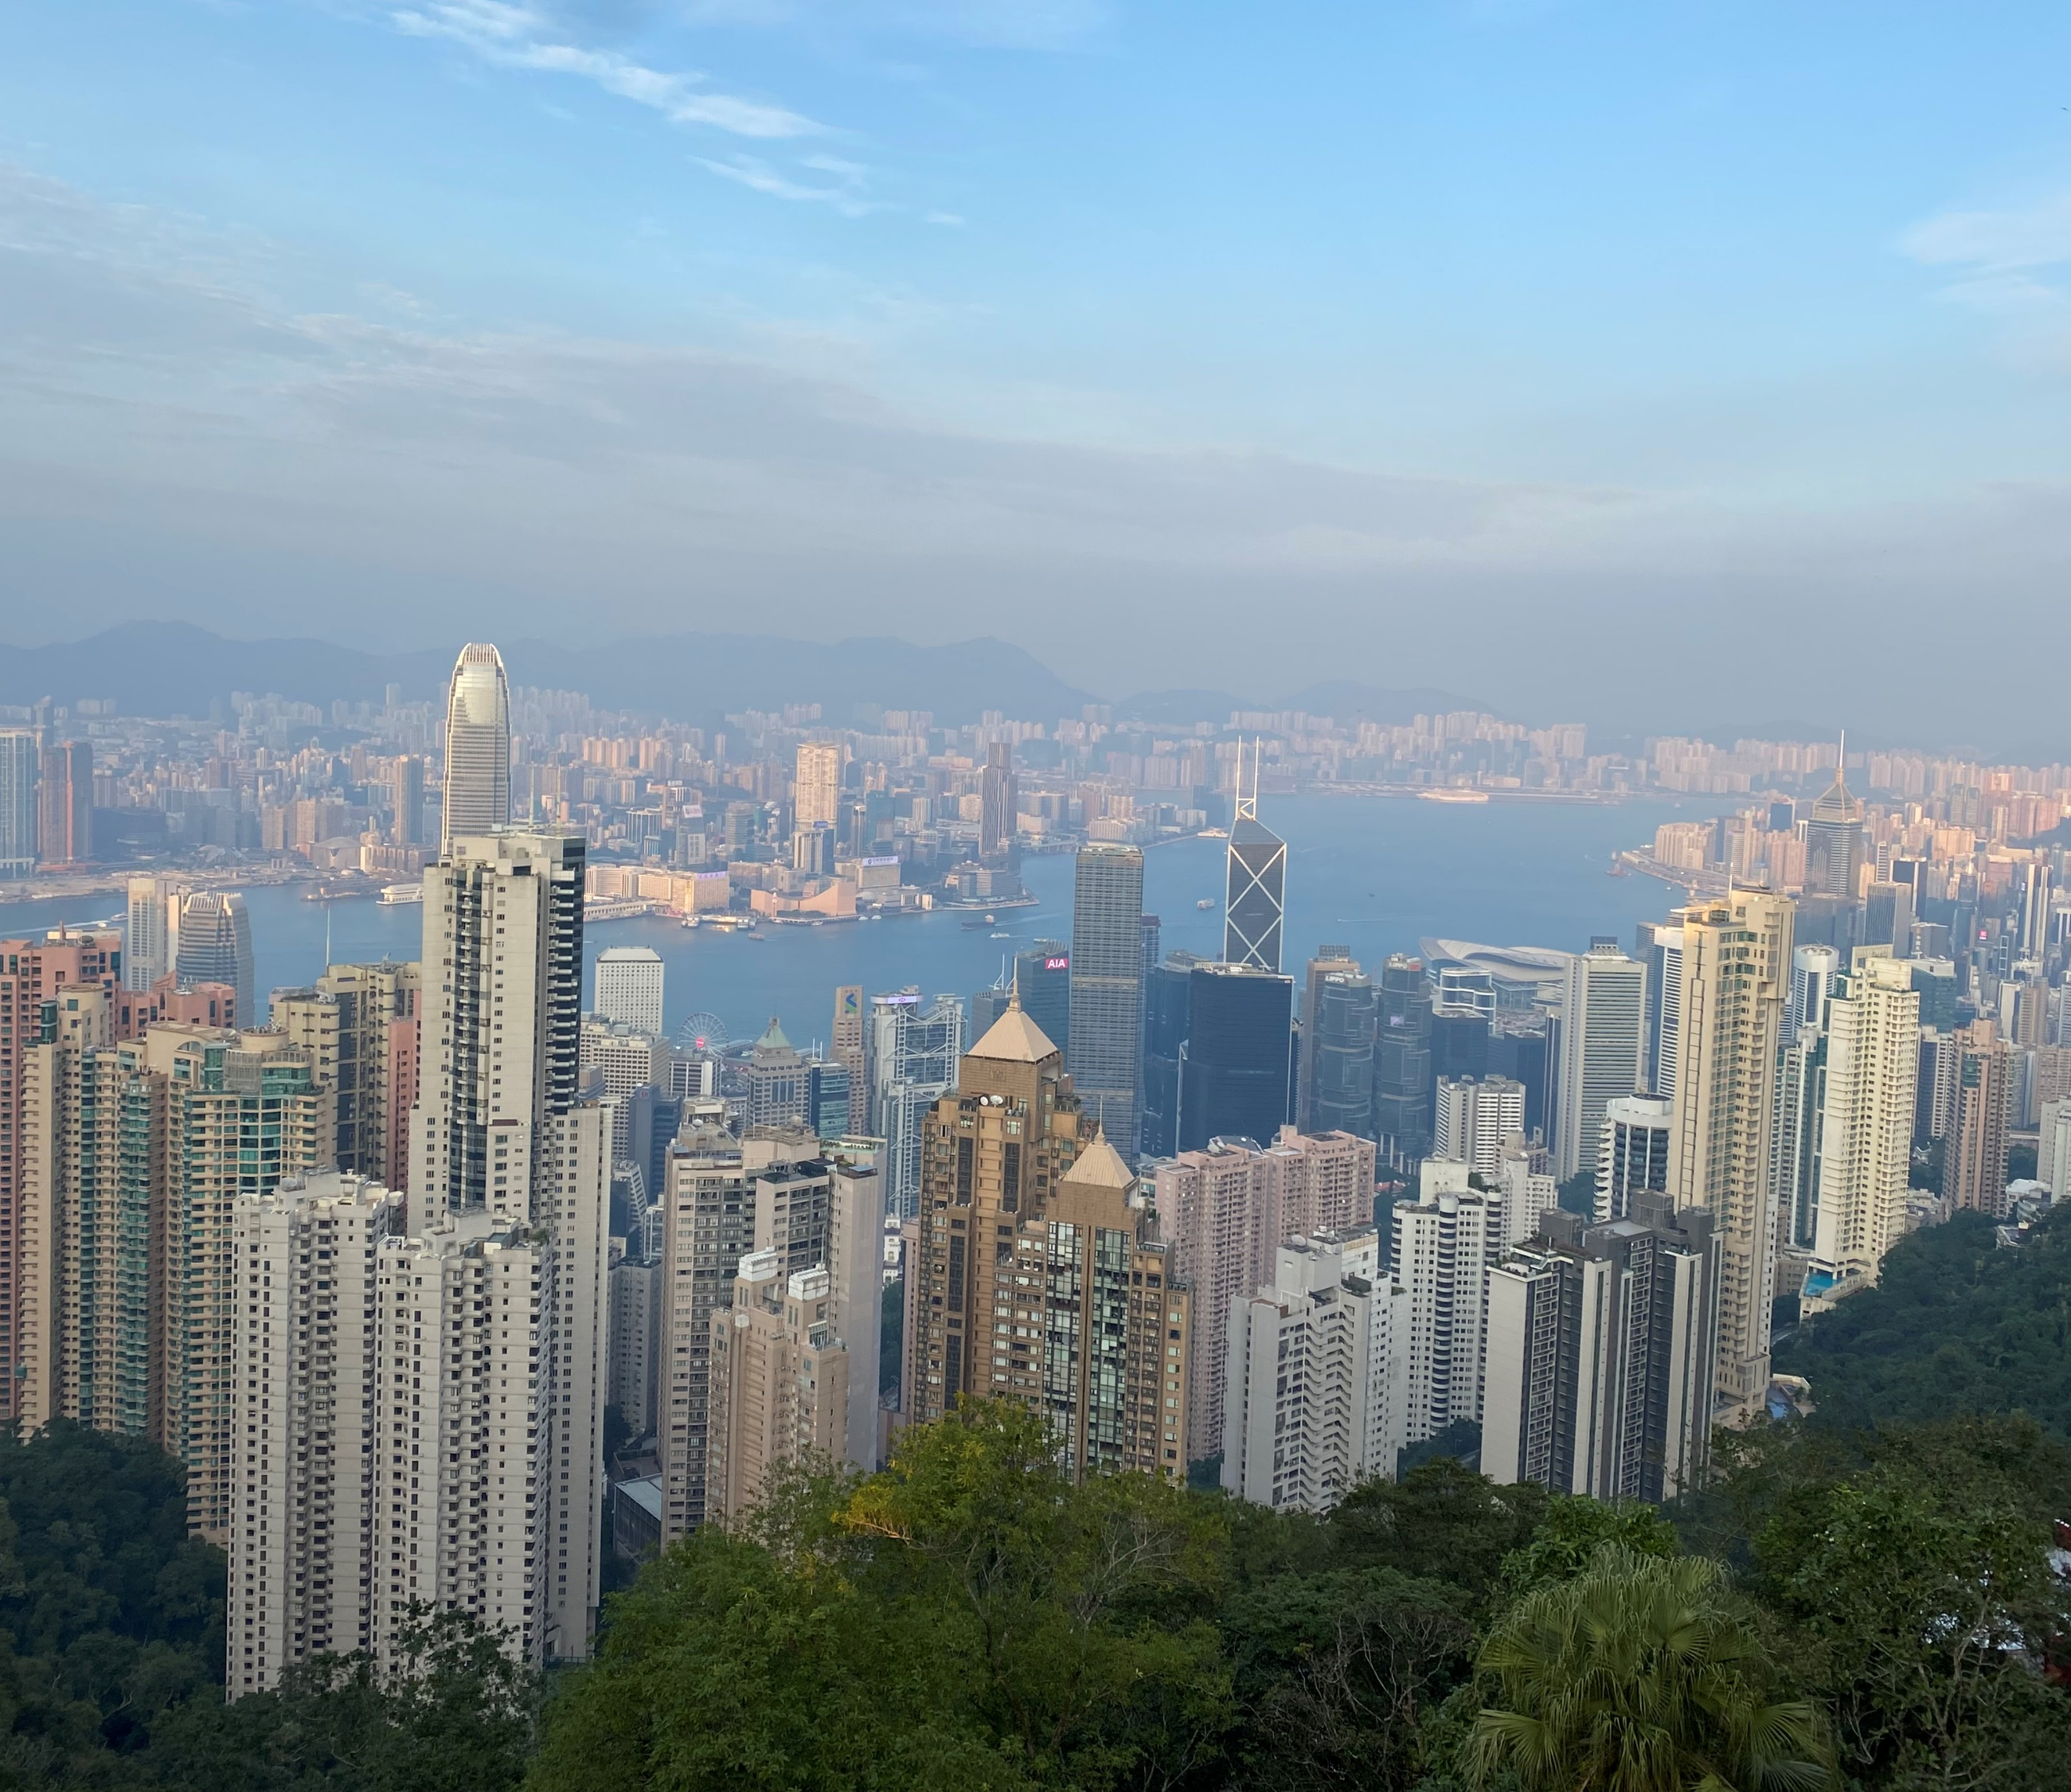
Calligraphy in Hong Kong’s Public Transport
Anson Dao

Slide 2
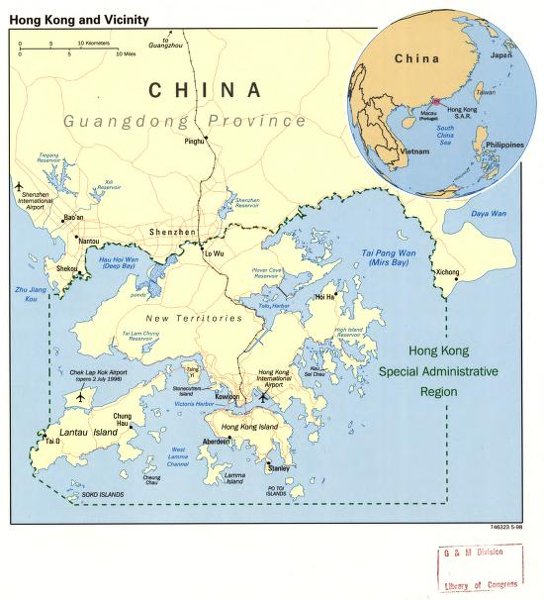
Background of Hong Kong
Special Administrative Region located in Southern China
British Colony from 1842 (Hong Kong Island) to 1997
Predominantly Cantonese speaking
Uses traditional characters not simplified
Simplified: 妈妈我祝你生日快乐
Traditional: 媽媽我祝你生日快樂
Phrase: Mom, I wish you Happy Birthday

Slide 3
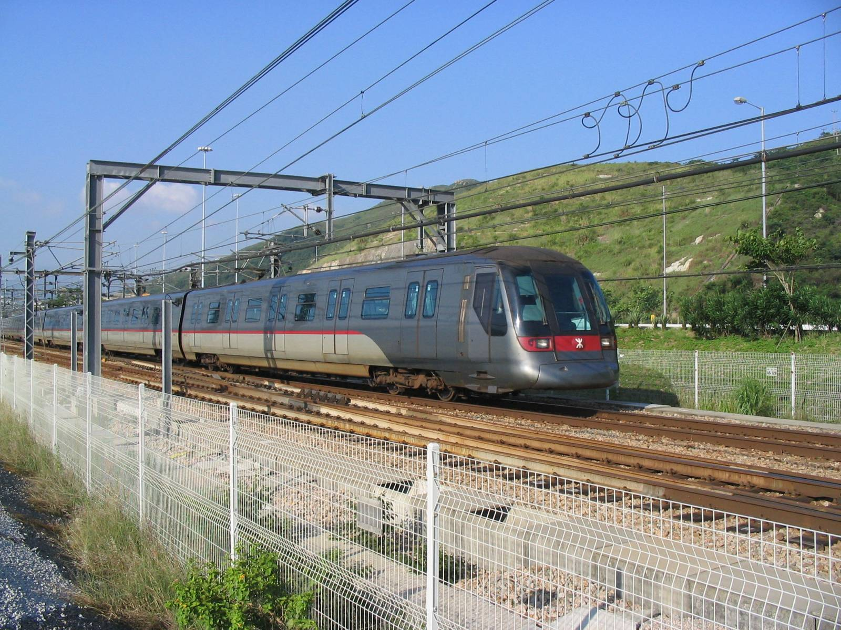
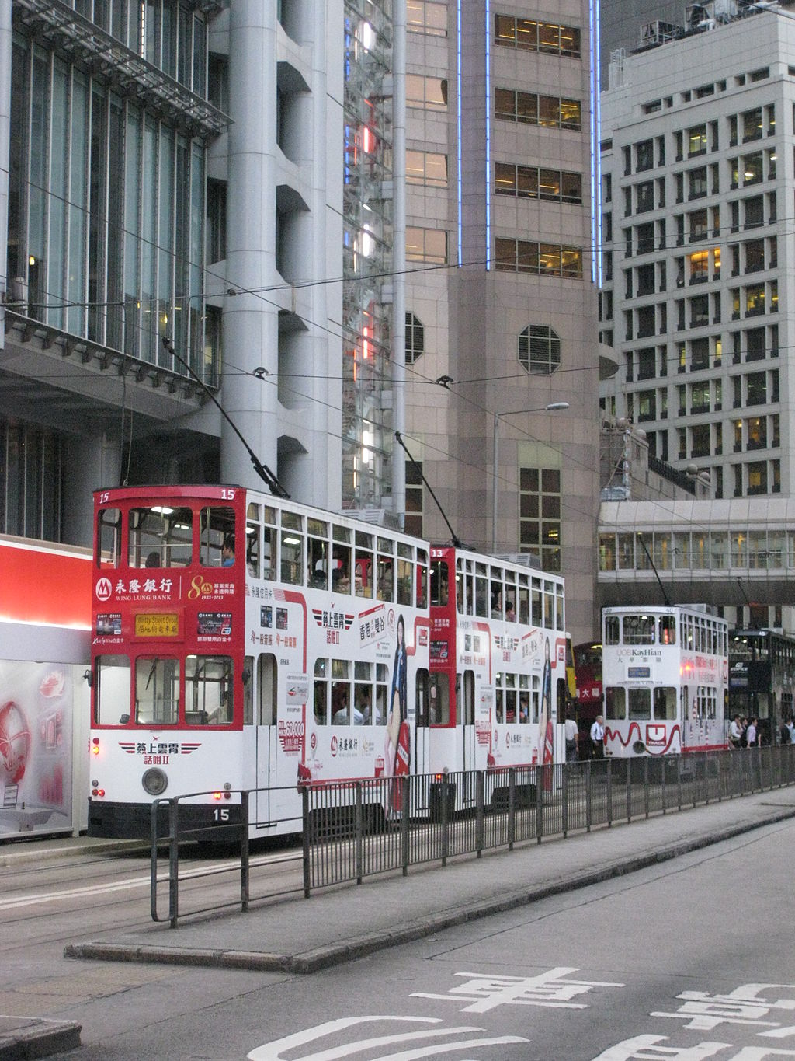
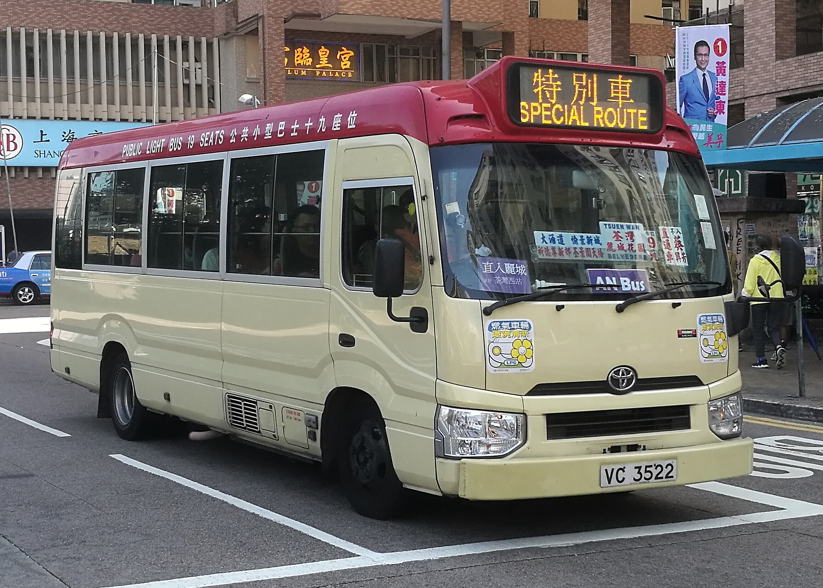
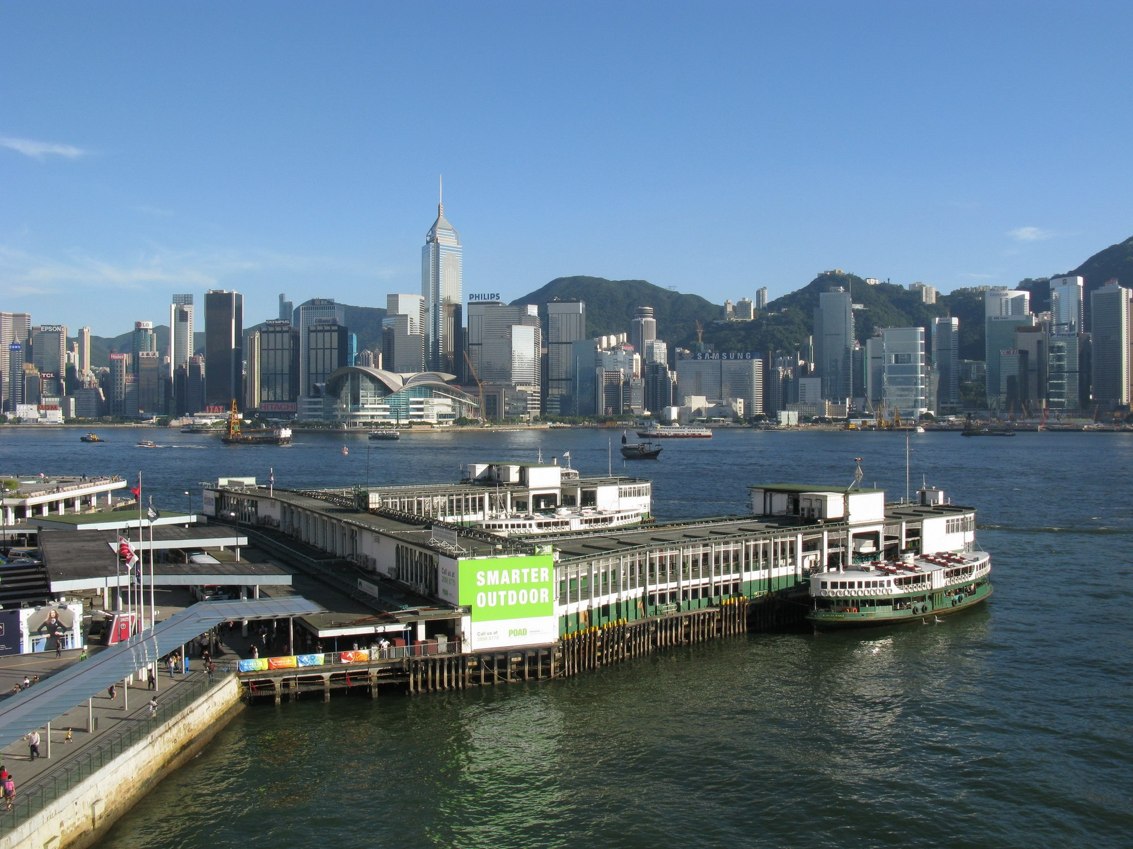
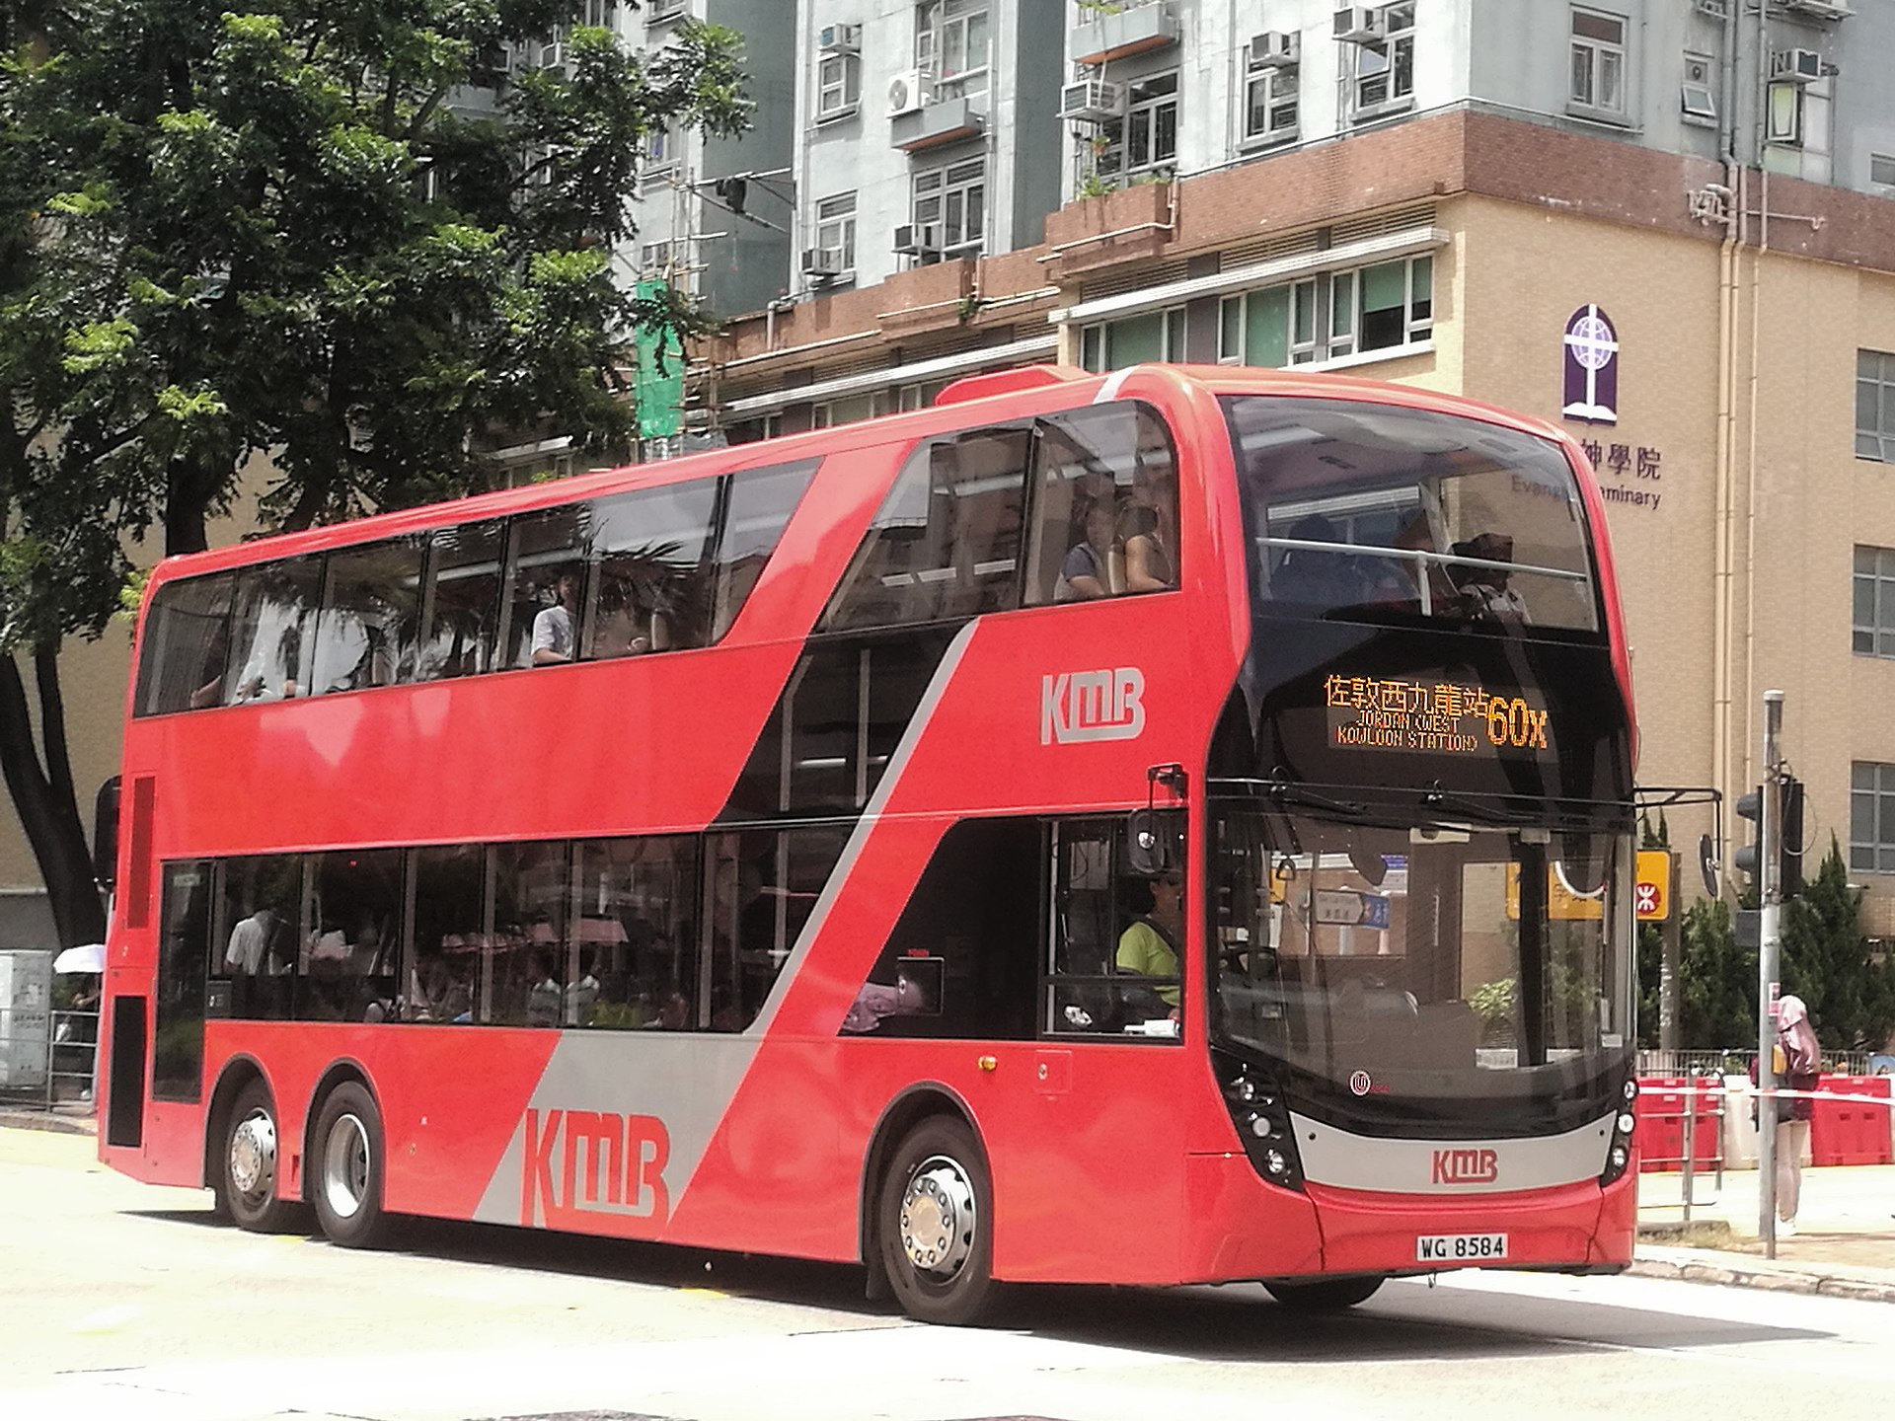
Public Transport in Hong Kong
Bus: Double Decker Bus
Minibus
Metro: MTR
Light Rail
Ferry
Tram: “Ding Ding”
And more

Slide 4
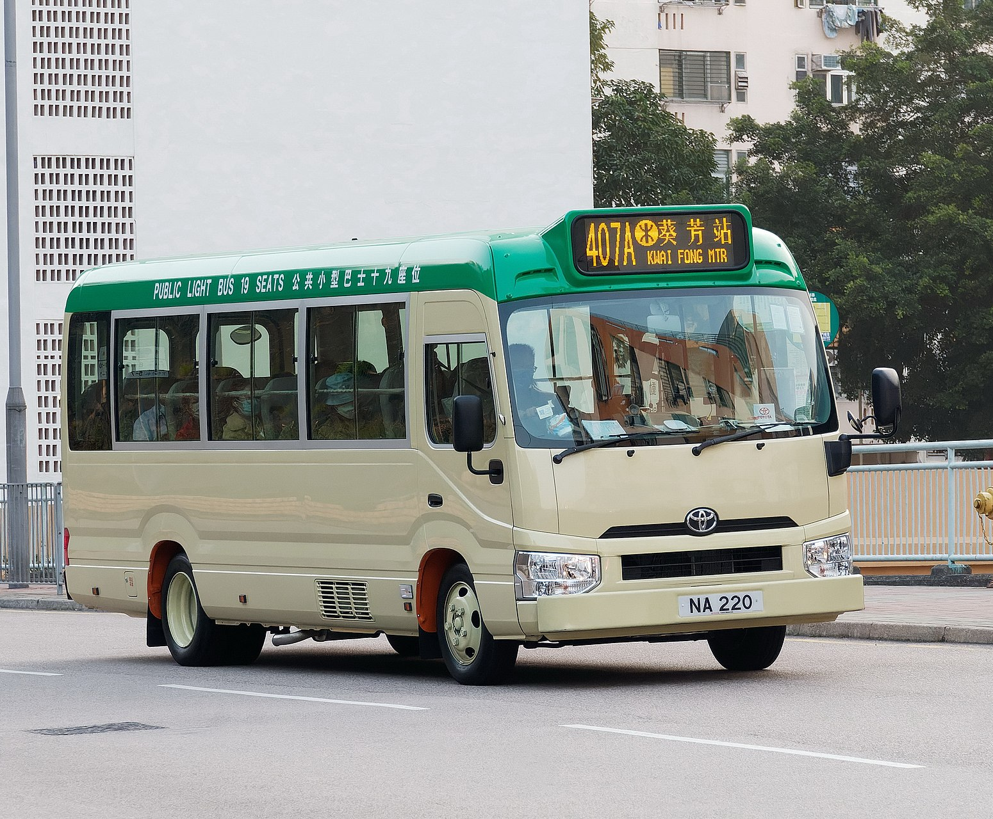
Minibus (小巴)
Two types
Red top: no set route, but set destination
Can access some areas not served as well by other forms of public transit
Fares not regulated by transit authority
Tends to drive more aggressively
Green top: set route with set destination
Have designated stops
Fares regulated by transit authority

Slide 5
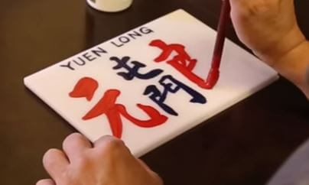
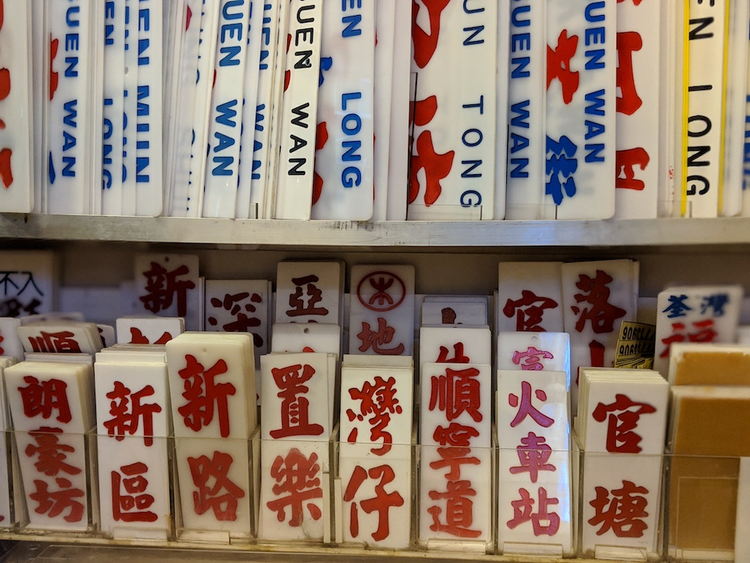
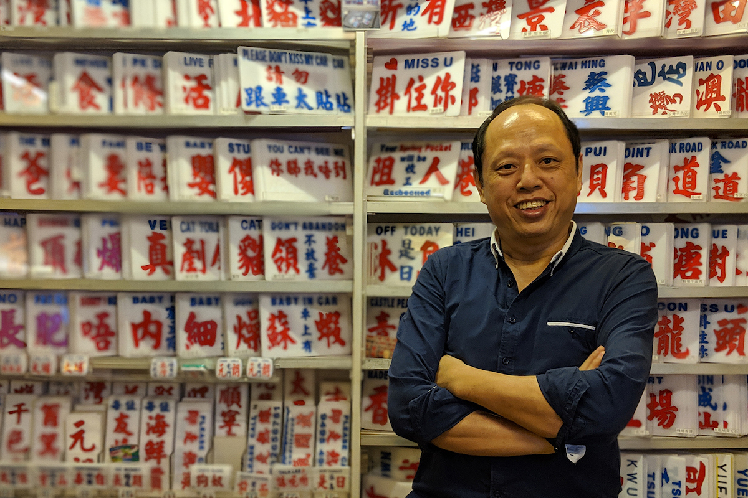
Minibus Sign
Paint on acryllic sheet
Mak Kam Seng is the last person in Hong Kong to make and sell Minibus signs
Makes signs with slang
Since red top minibuses can operate anywhere, custom signs help make destinations clearer
Decline of red minibuses means decline in demand for custom signs
Red characters means destination
Blue characters means a neighborhood it will pass through
Uses regular script

Slide 7
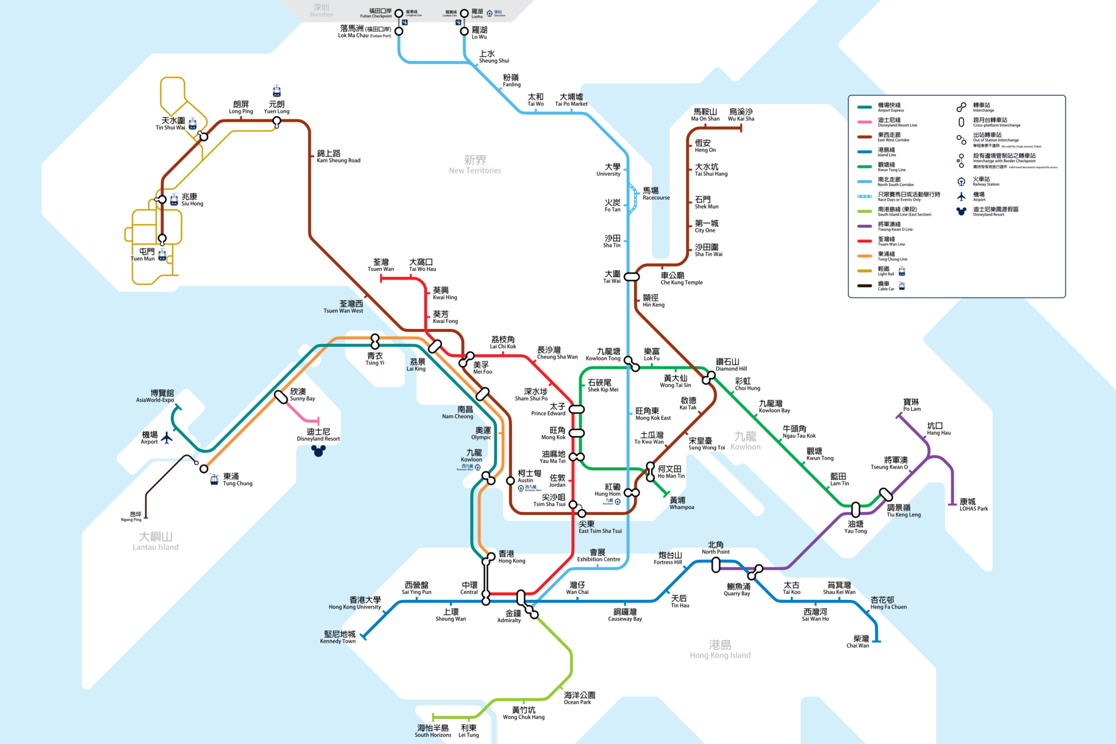
MTR
Mass Transit Railway
Founded in 1972
Merged with KCR in 2007
10 lines, 98 stations
Helps foster transit-oriented development

Slide 8
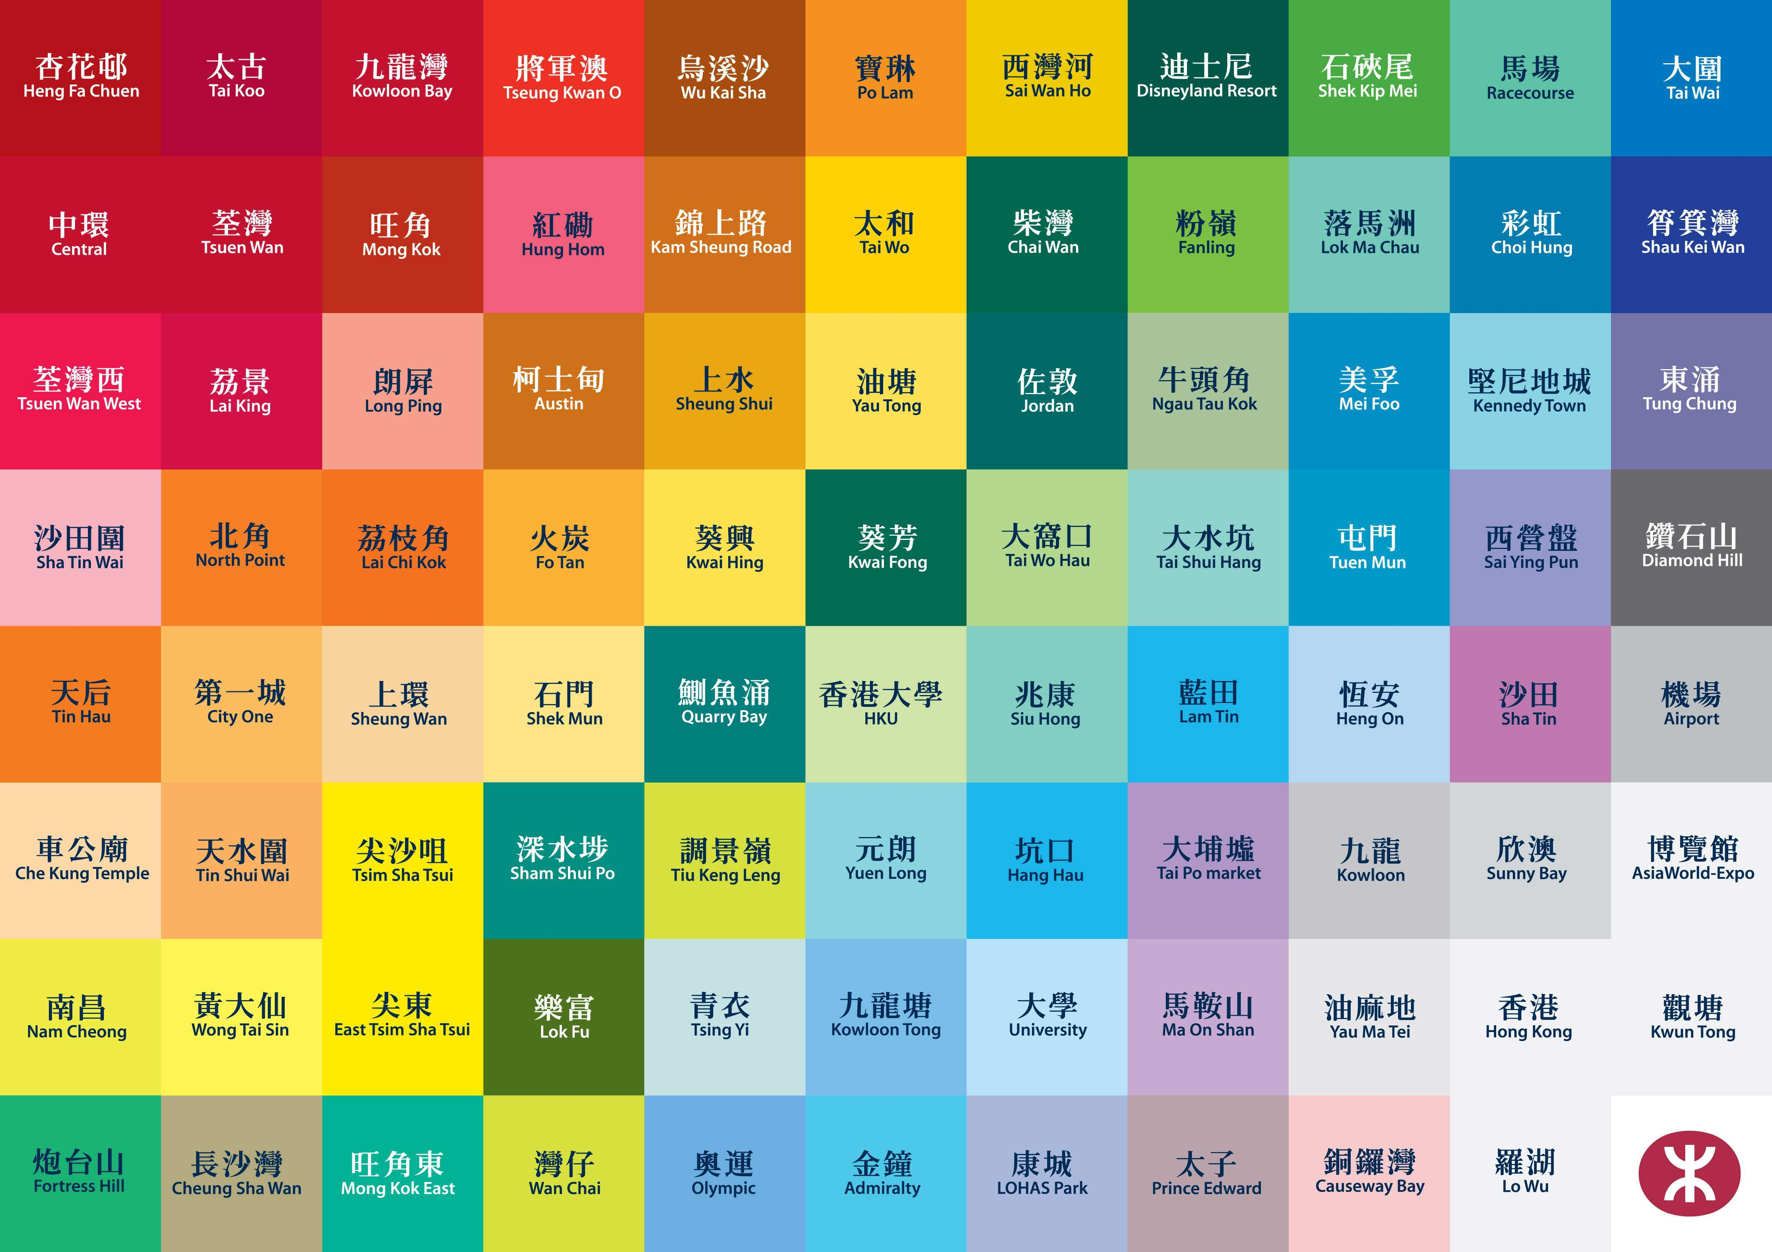
Livery

Slide 9
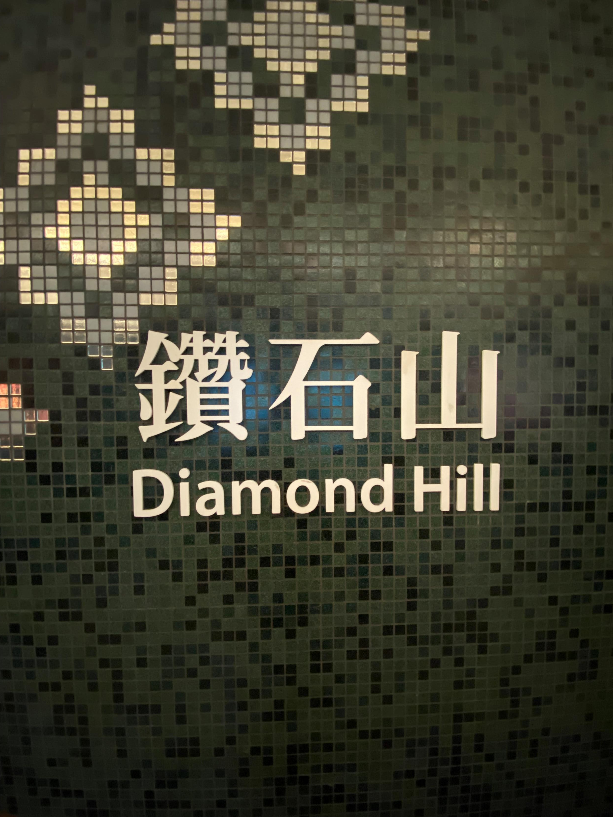
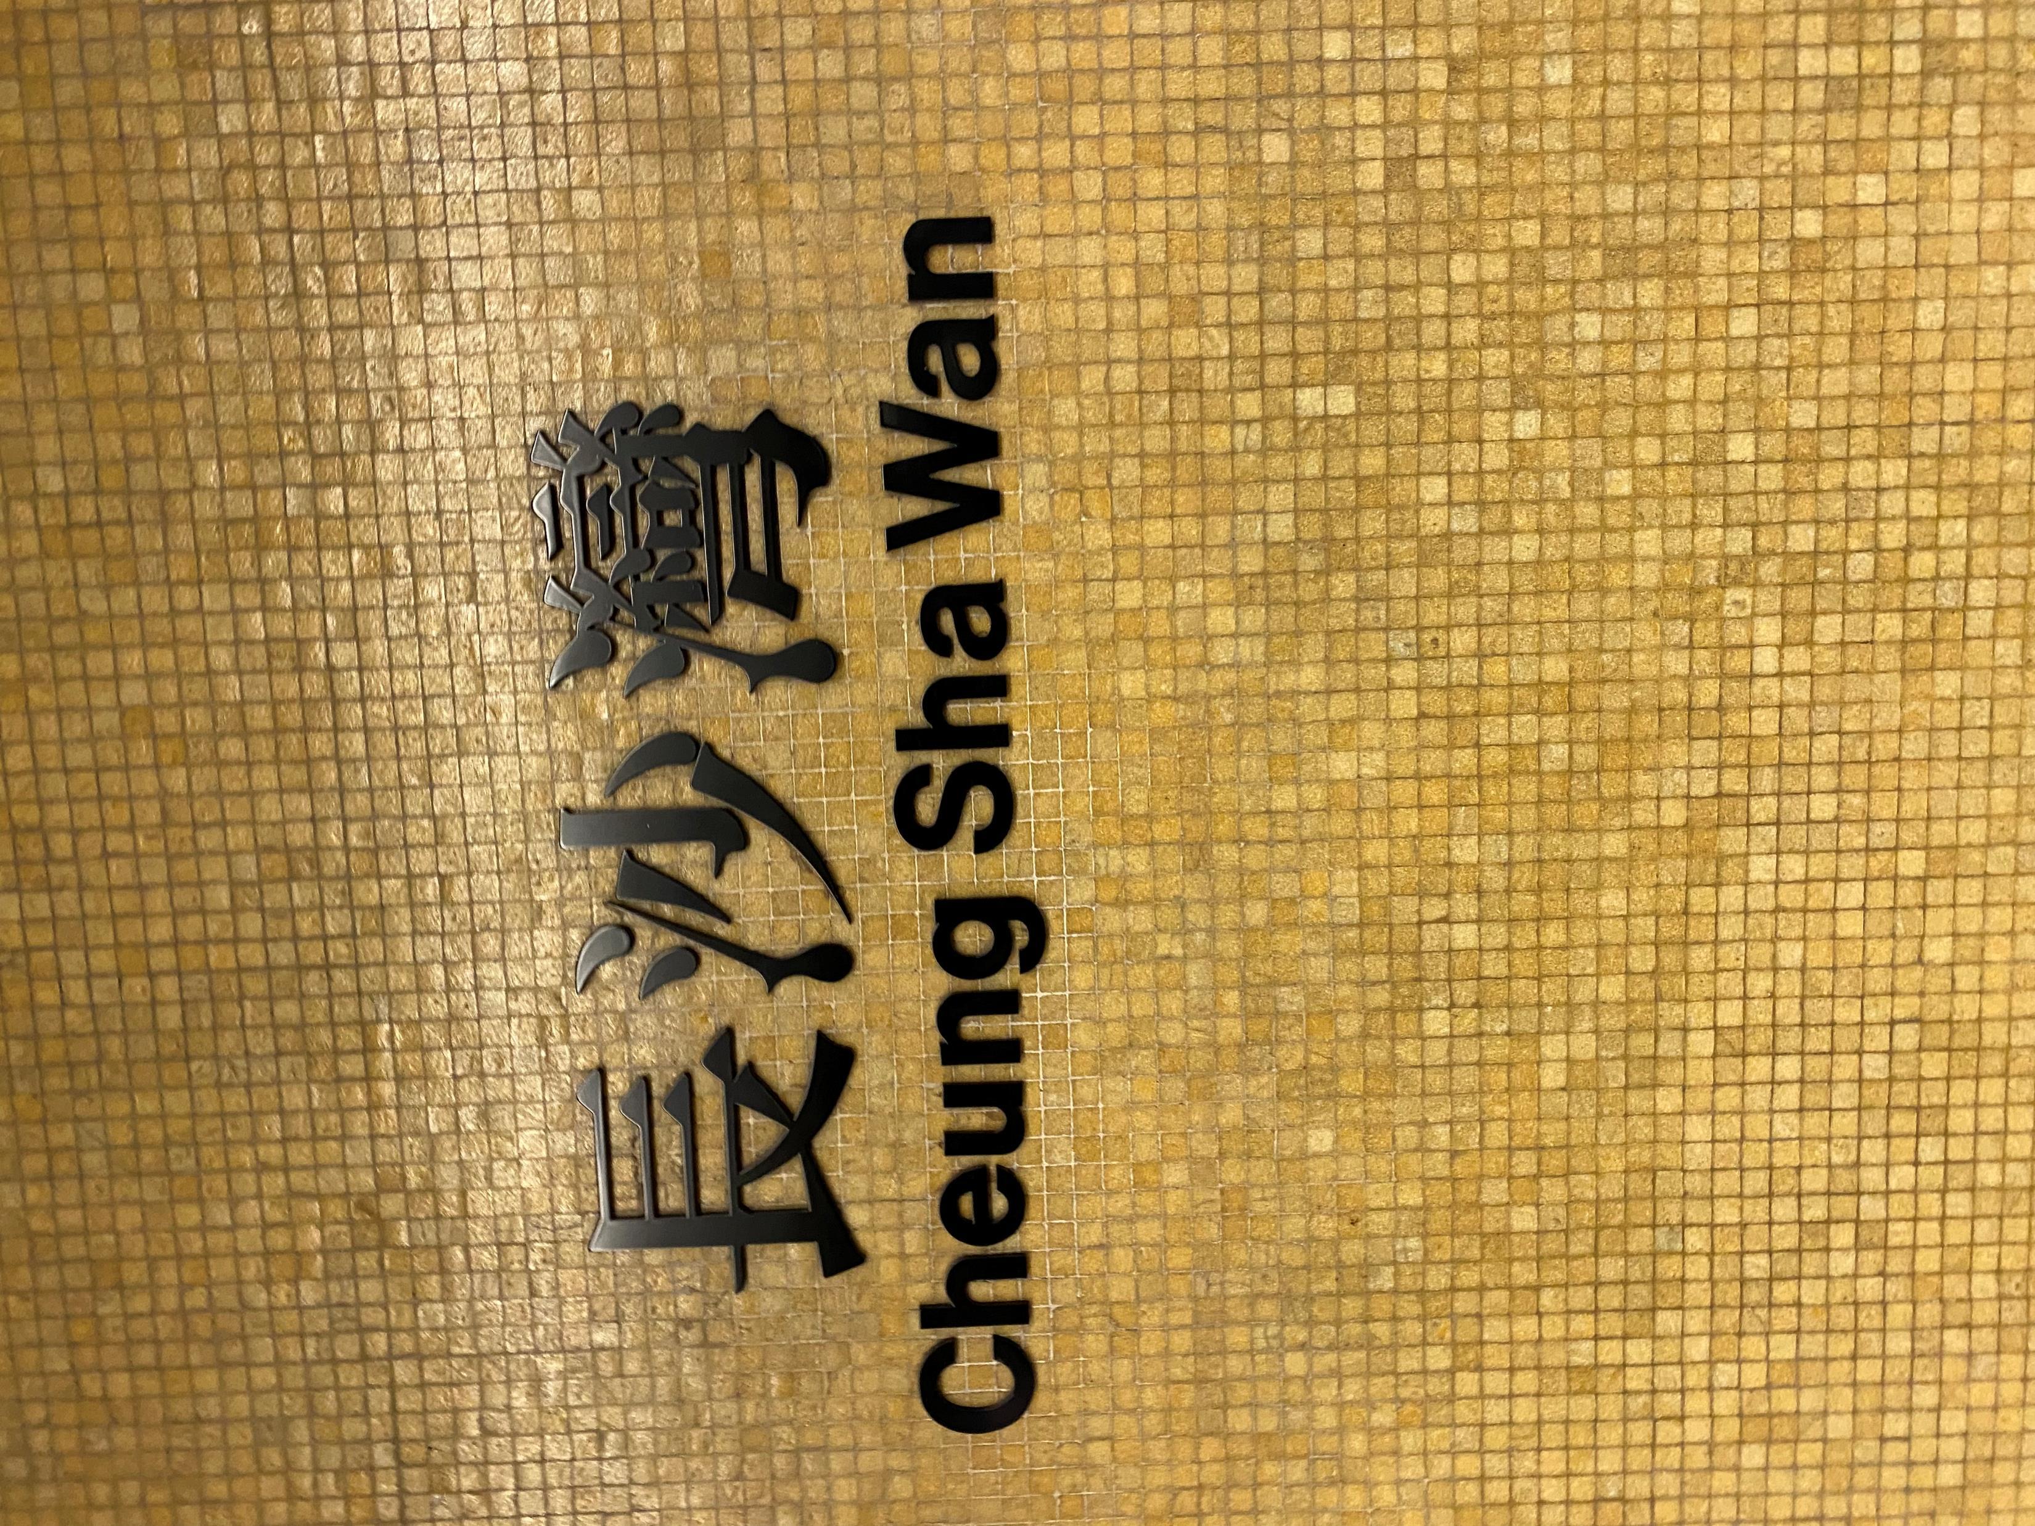
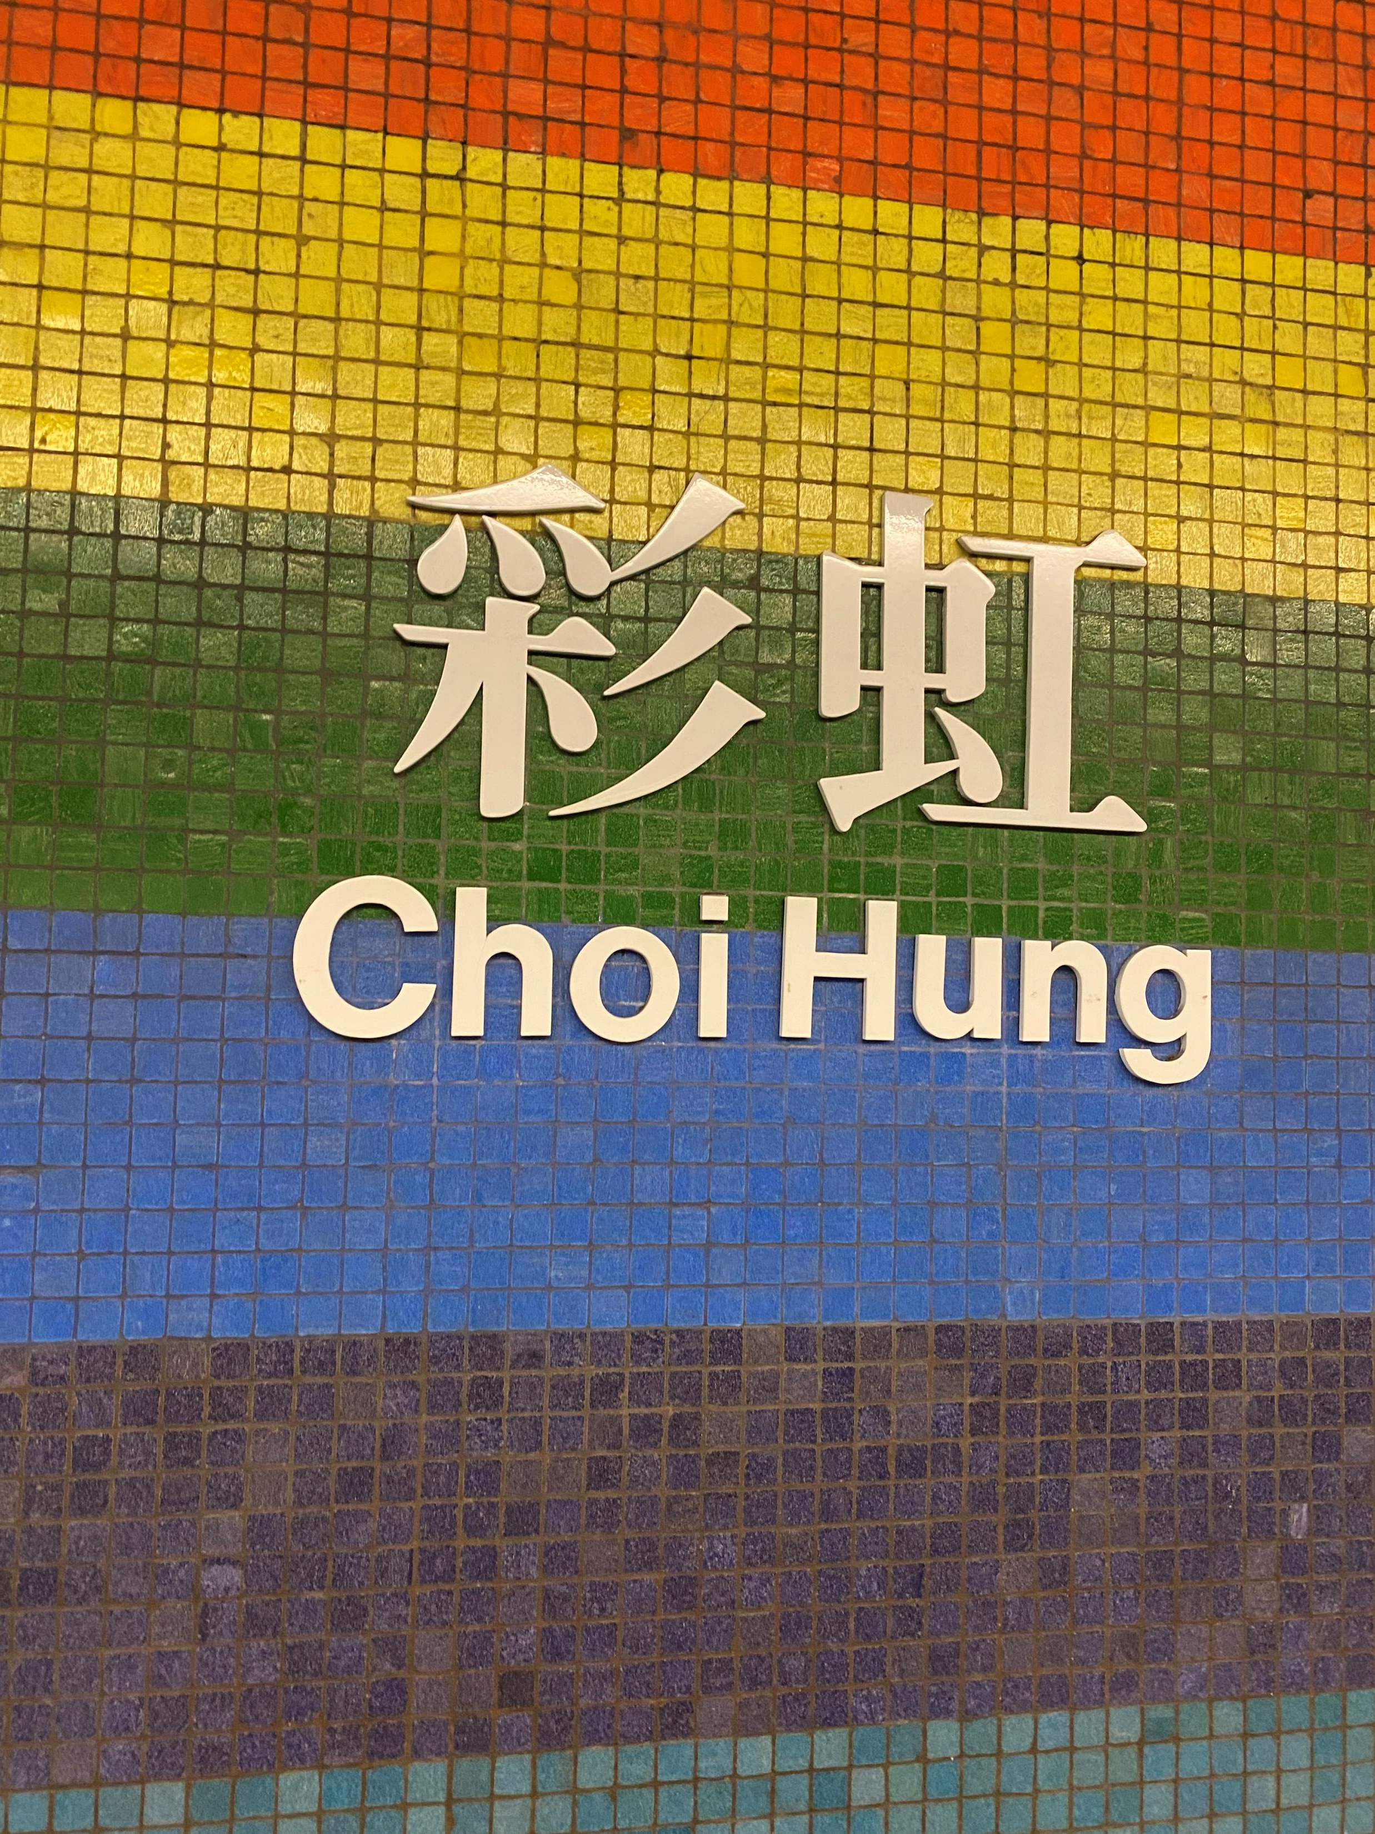
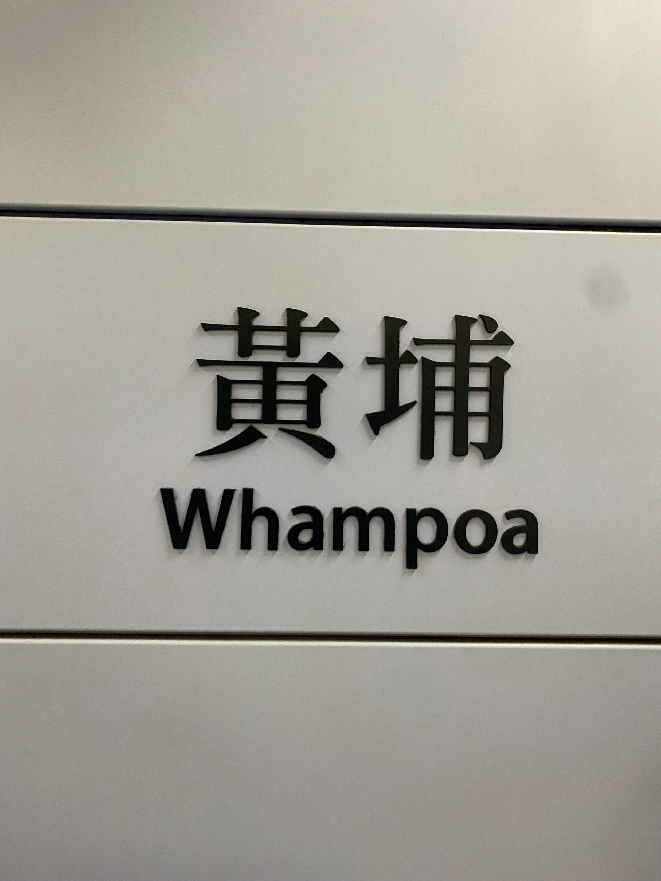
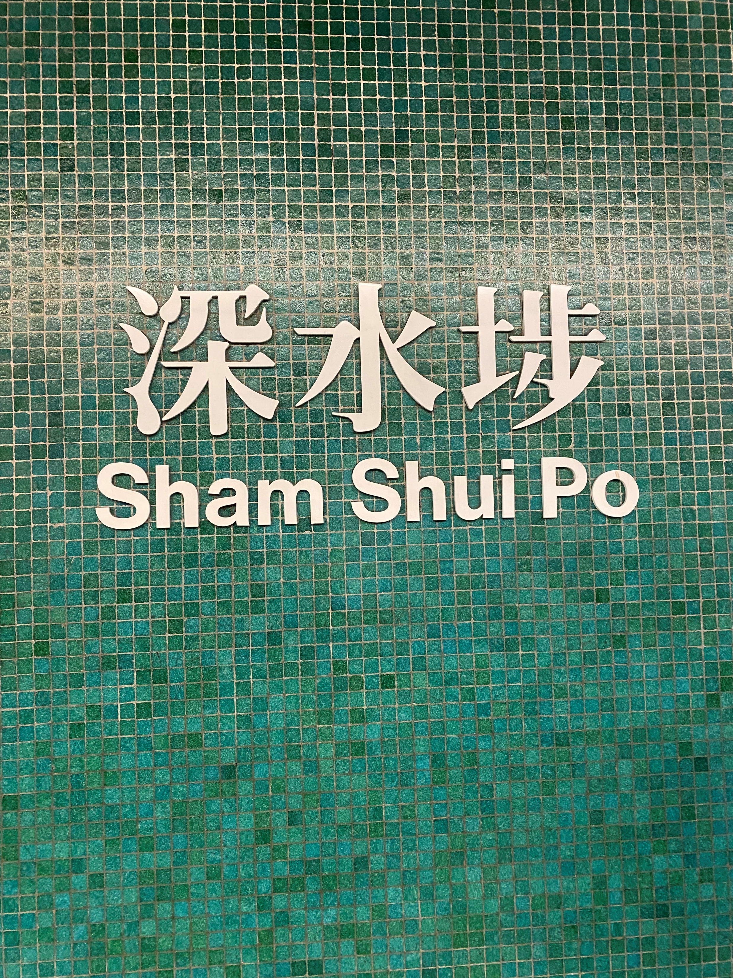
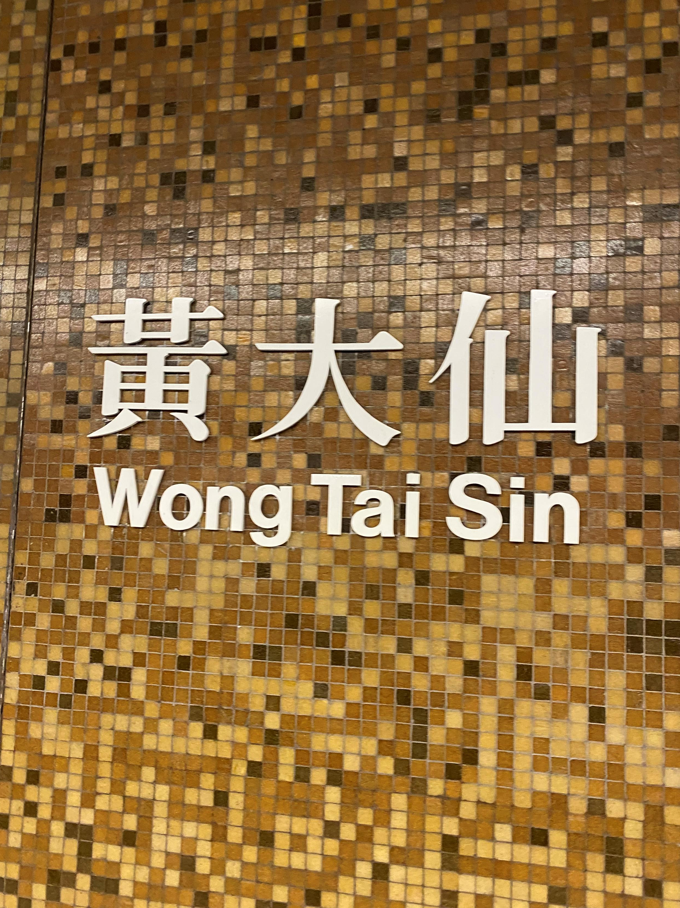

Slide 10
Calligraphy in MTR
Mainly found in Island Line, Tseung Kwan O Line, and newer stations
Written by Abe Au Kit-Tong
Wanted to remind people that Chinese Calligraphy still exists, since it has been in decline
Wrote in a Song Dynasty style
Xingshu running script
Written on panels rather than mosaics
Along with the livery brings life to the station
Make it brighter rather than a dark and desolate place

Slide 11
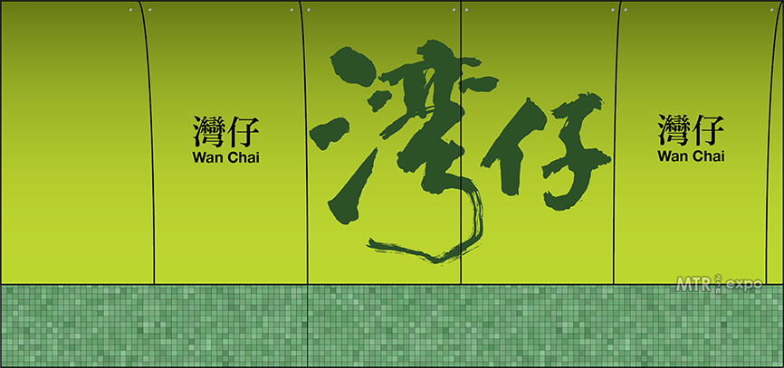
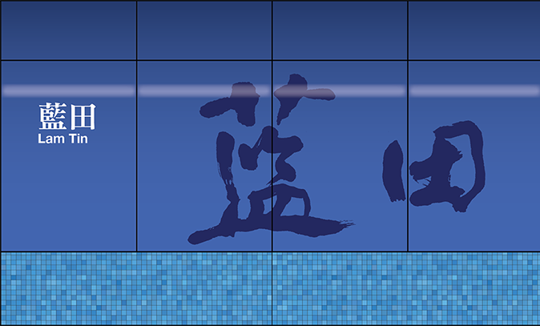
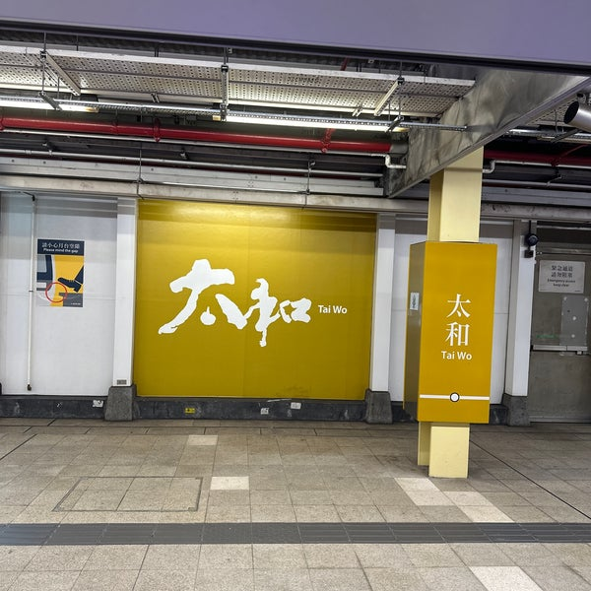
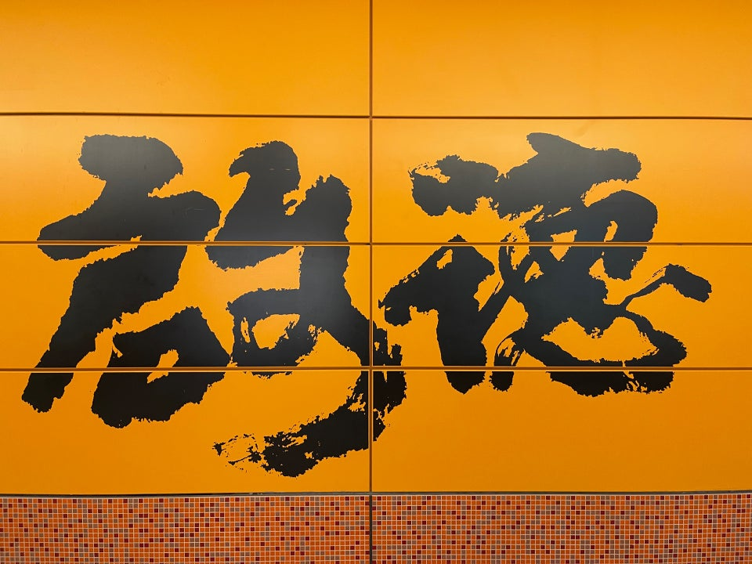
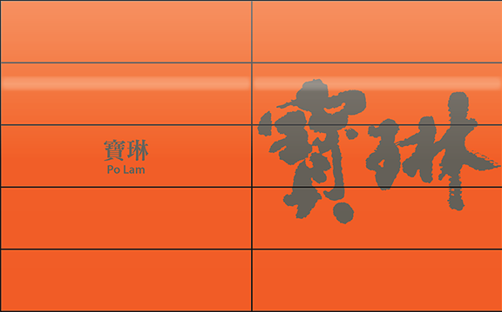

Slide 12
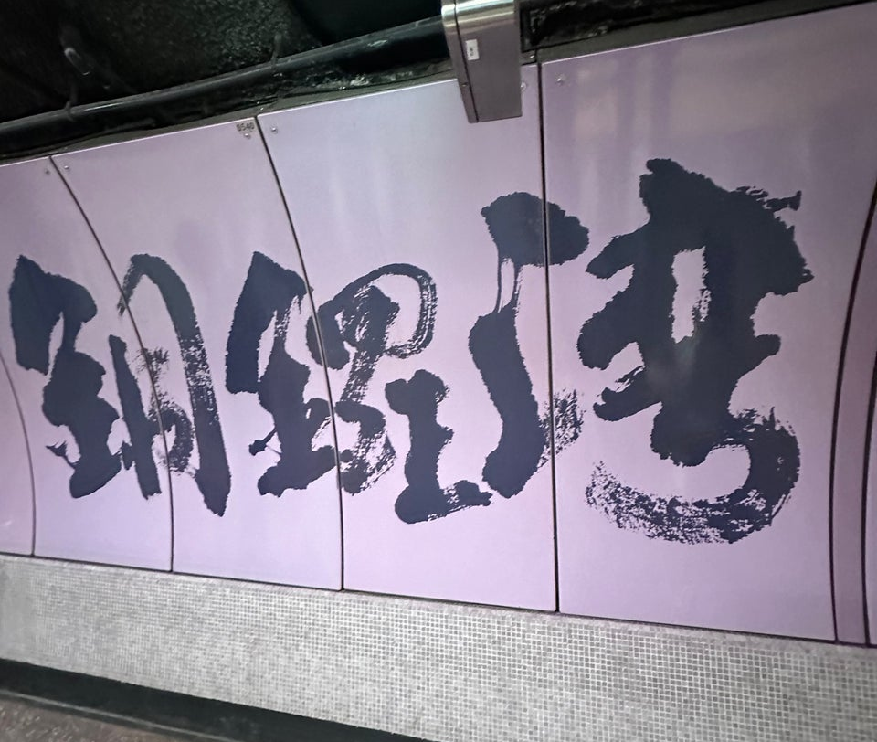
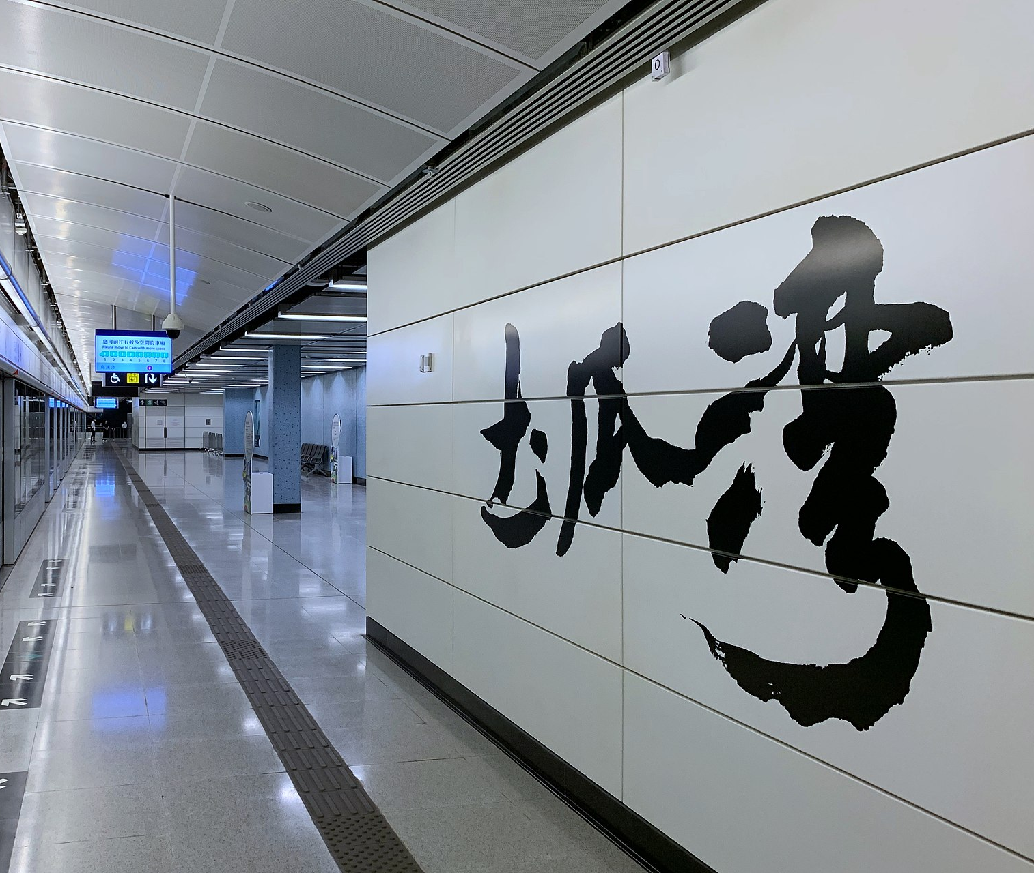
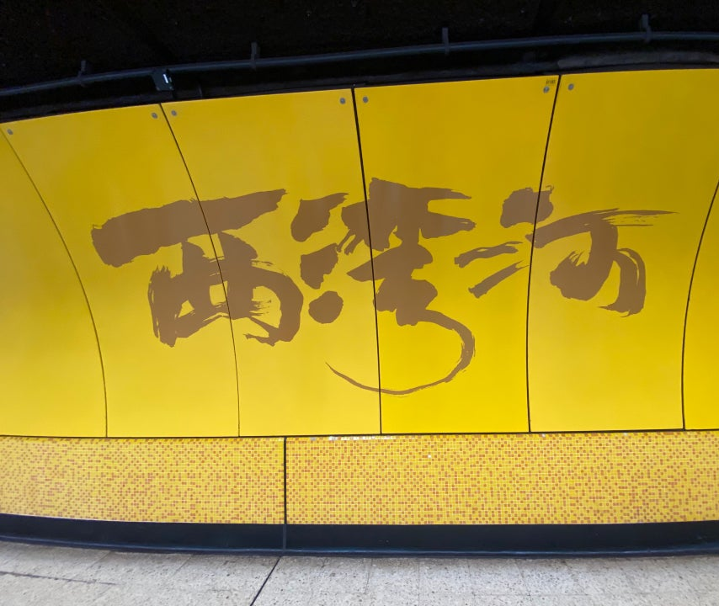

Slide 13
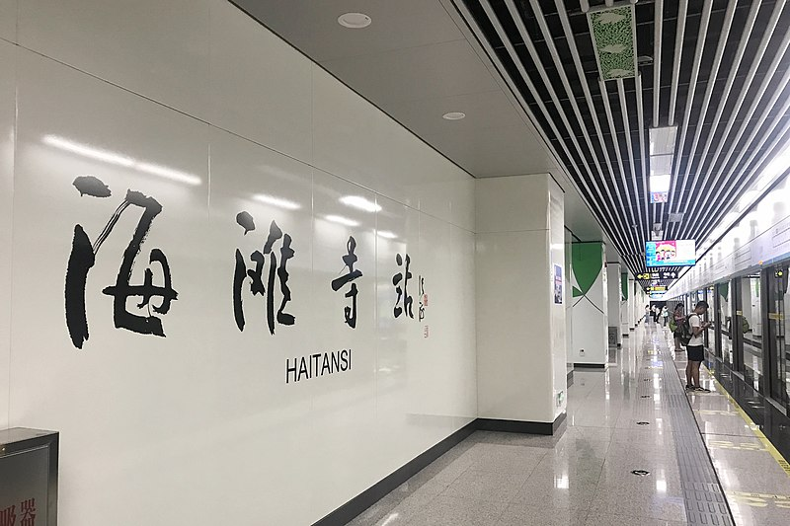
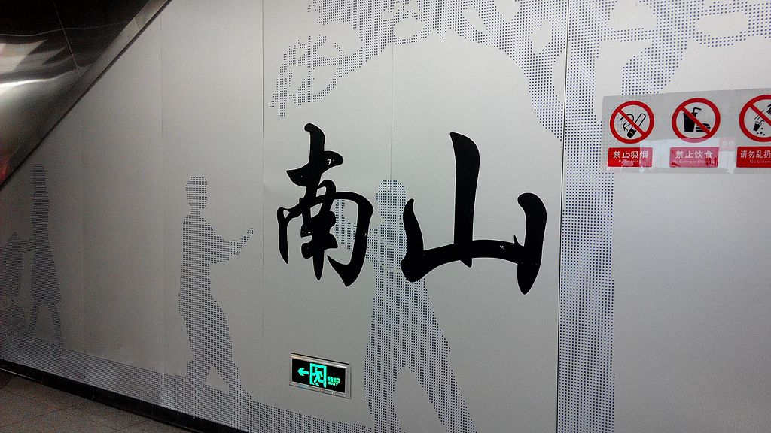
Zhengzhou Metro
Shenzhen Metro

Slide 14
Effects of Calligraphy in Hong Kong Public Transport
People of Hong Kong like the feeling of nostalgia
Bridging together oriental and occidental culture
An art form that can brighten up the public
Reviving a dying tradition
Hope to expose as many people as they can to this art form
Dynamic nature

Slide 15
Works Cited
https://www.britannica.com/place/Hong-Kong
https://tile.loc.gov/image-services/iiif/service:gmd:gmd7:g7823:g7823h:ct000381/full/pct:25/0/default.jpg
https://en.wikipedia.org/wiki/MTR
https://en.wikipedia.org/wiki/Transport_in_Hong_Kong
https://hongkongfreetours.com/minibus-sign/
https://industrialhistoryhk.org/the-last-minibus-sign-writer-in-hong-kong/
https://zolimacitymag.com/forgotten-hong-kong-icon-the-last-minibus-sign-maker/
https://www.scmp.com/yp/discover/lifestyle/features/article/3071072/why-are-hong-kongs-mtr-stations-different-colours
http://www.xinhuanet.com/english/2021-07/19/c_1310070061.htm
http://mtr.hk365day.com/Railway/Special/calligraphy/main.html
https://foursquare.com/v/mtr-tai-wo-station/4b9858dff964a5201d3d35e3/photos
https://foursquare.com/v/mtr-causeway-bay-station-%E9%8A%85%E9%91%BC%E7%81%A3%E7%AB%99/4b29bb26f964a520fca224e3/photos
https://commons.wikimedia.org/wiki/File:20190619_Calligraphy_at_Zhengzhou_Metro_Haitansi_Station.jpg
https://zh.wikipedia.org/zh-cn/File:Shenzhen_Metro_Line_11_Nanshan_Sta_Platform_Calligraphy.jpg
https://youtu.be/rl4ha2Q1Wv8?si=Eb7kV3uIDzt0tjHn
All other pictures are taken by me, Anson Dao

