Slide 1
History of Western Calligraphy
Alex Yang

Slide 2
General Timeline
Roman Empire (1st century AD)
Roman Capitals/Roman Rustic
Post Roman Era (7-8th century AD)
The Middle Ages (5th to 13th century AD)
Beneventan Script, Carolingian Script, Gothic Calligraphy
Humanist Script
Renaissance (13th to 17th century AD)
Baroque Era (17th century to 18th century AD)
Copperfield and Spencerian Scripts
Latin Alphabet invented around 600 BC
First scripts were developed during this time
Next development of scripts originated in Ireland in the 7th century.
Unical Script
An era of ‘’rebirth’’ for Western Europe
Upcoming prosperity in art, science, economy, and other activities
Fall of the Western Roman Empire
It as marked by economic, intellectual, and cultural decline.
During time of the French Revolution and then American Revolution

Slide 3
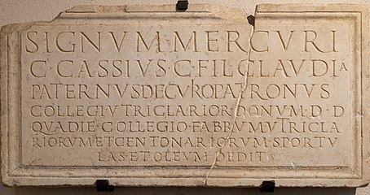
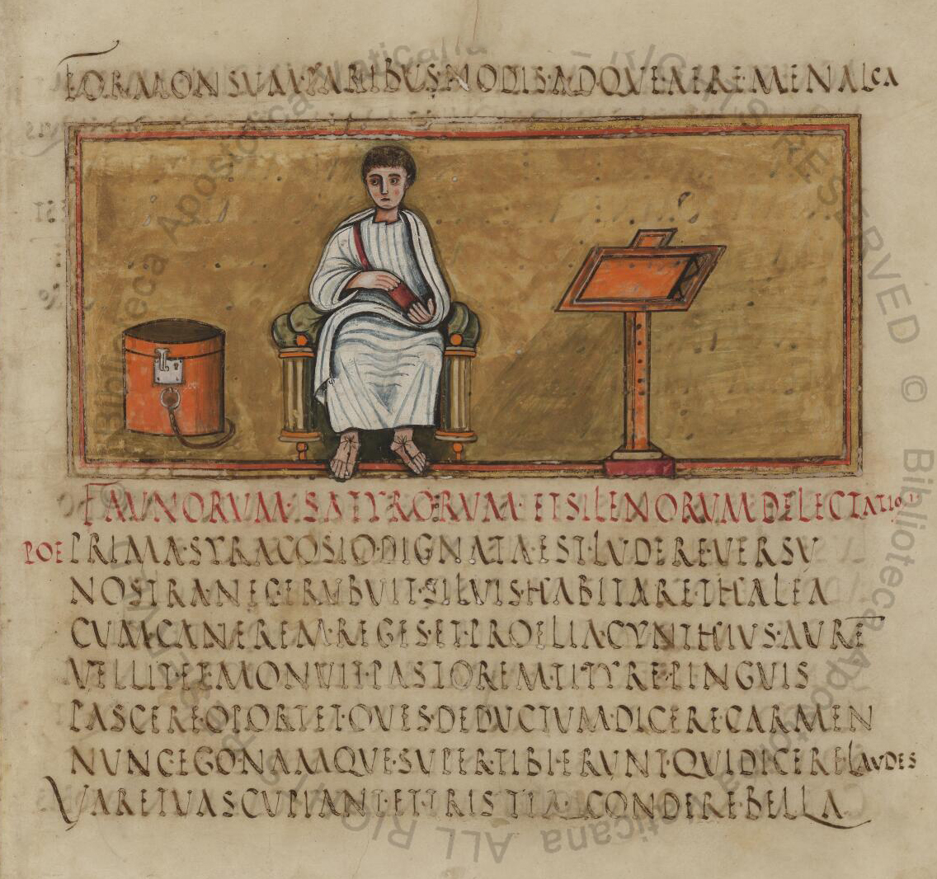
Roman Empire
Roman Capitals
Emerged around the first century AD
The single most influential historical script
Known for its geometry and precision
Used for stone engraving and more formal occasions.
Rustic Capitals
Similar to Roman Capitals
Common script for everyday use
Mostly painted with flat brushes or nibs

Slide 4
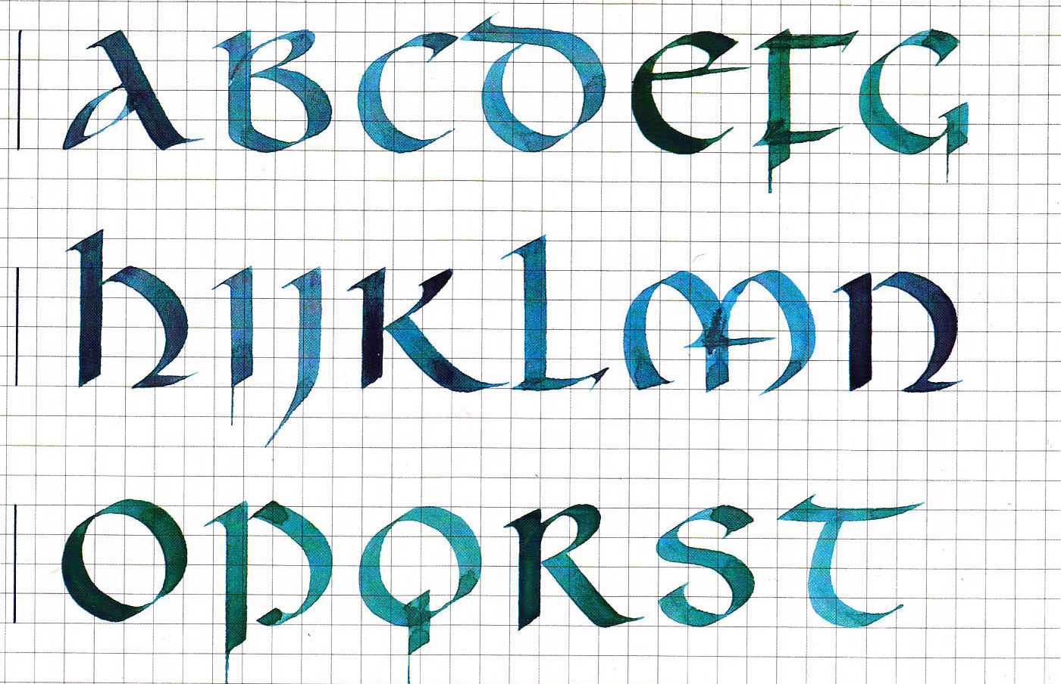
Post-Roman Era
Uncial Script
Emerged in the early 8th century
New script influenced by the Greek alphabet
Characterized by bold and curved strokes
Allowed for faster writing
Ideal for copying manuscripts such as holy scriptures
Christian churches promoted the development of this writing through prolific copying of the Bible and other sacred texts.

Slide 5
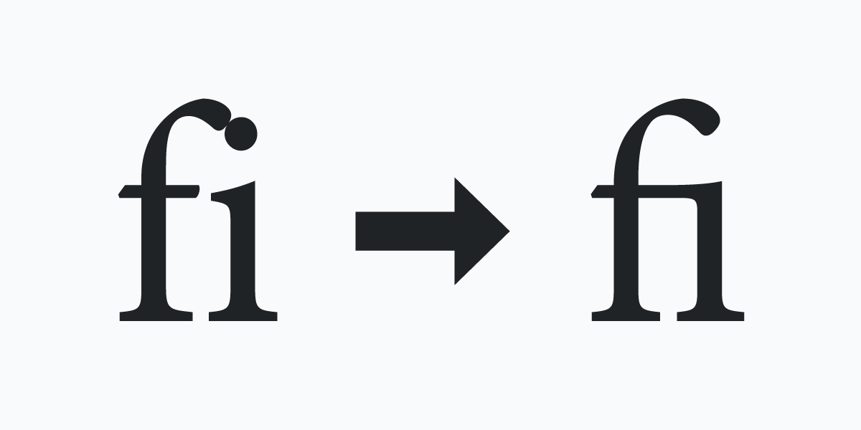
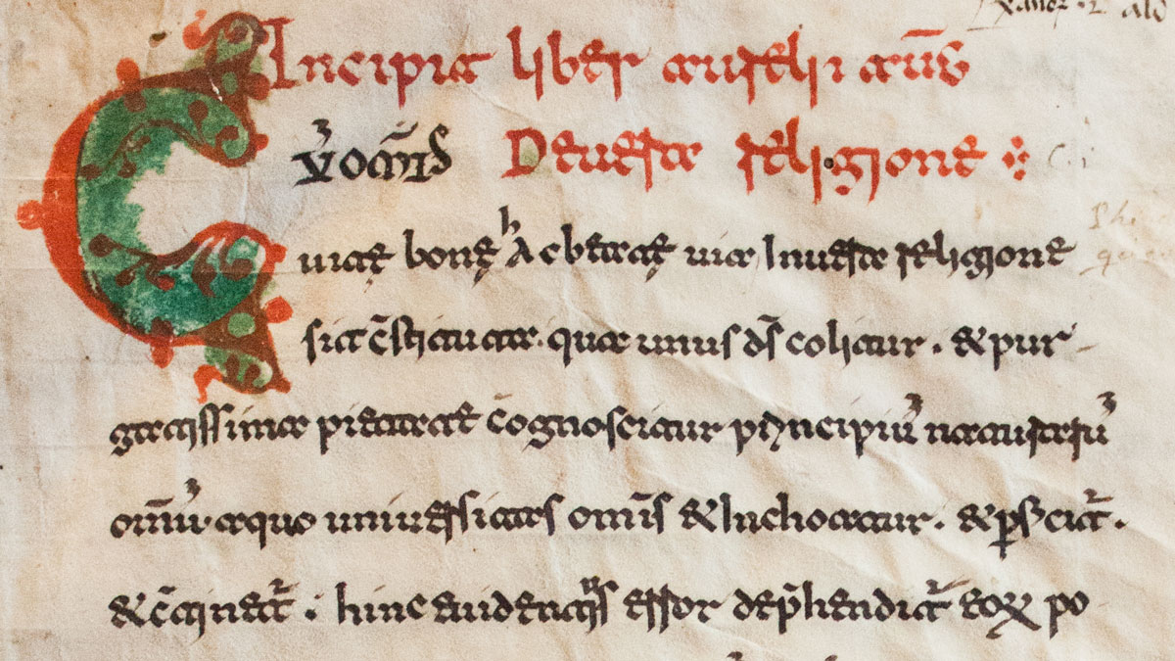
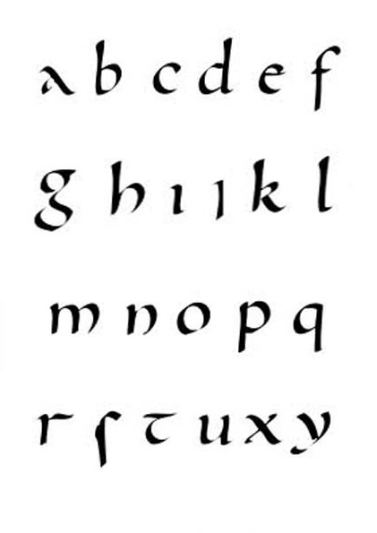
The Middle Ages
Beneventan Script
Influenced by the Uncial script
Defining characteristics of the script are the use of ligatures and connecting strokes
The Beneventan script originated from the southern parts of Italy
Carolingian Script
Known for being a script that was relatively easy to read and write
Established as a part of King Charlemagne's educational reforms in the 8th century
Formed the basis for the lowercase alphabet that we use today
Gothic Script or Black Letter Script
Distinguished by thick and angular strokes and shapes
Inspired by the Carolingian script
Was used for manuscript books and documents throughout Europe—especially in German-speaking countries around the 12th to 20th century

Slide 6
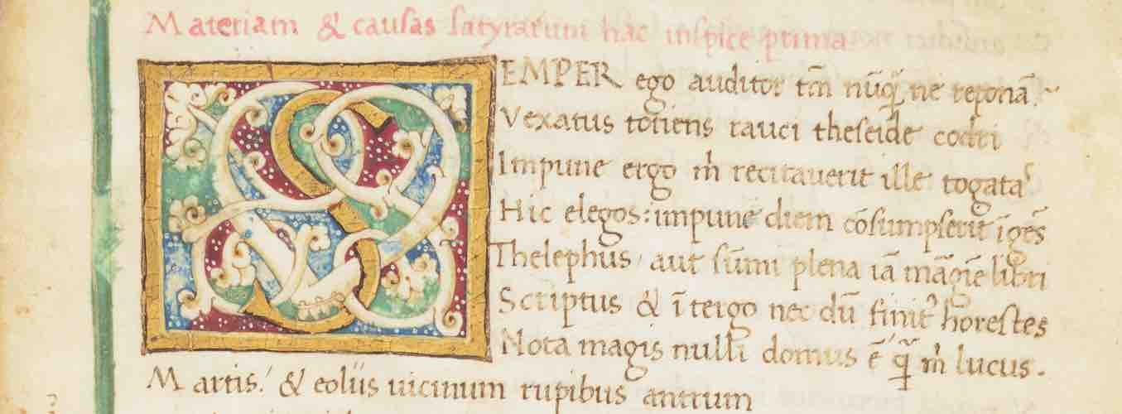
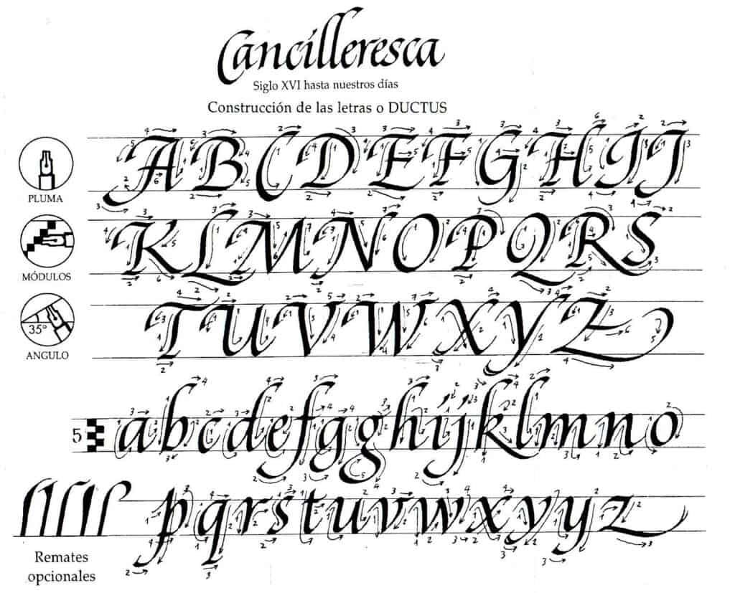
The Renaissance
Humanist Script
Even though gothic script that was the dominant script being used, the Italians did not really like using it.
Too impractical to write
As a result, the Humanist script was invented in Italy
Influenced by Carolingan script with its clear and simple style
To further simply the script, the script eventually evolved into the Italic script
Italic Script (or Cancellaresca script)
Required fewer strokes and could be joined with other letters.
Served as basis for cursive writing

Slide 7
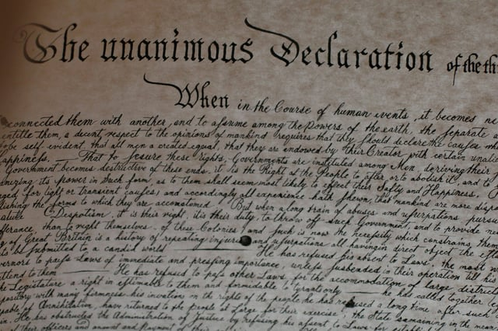
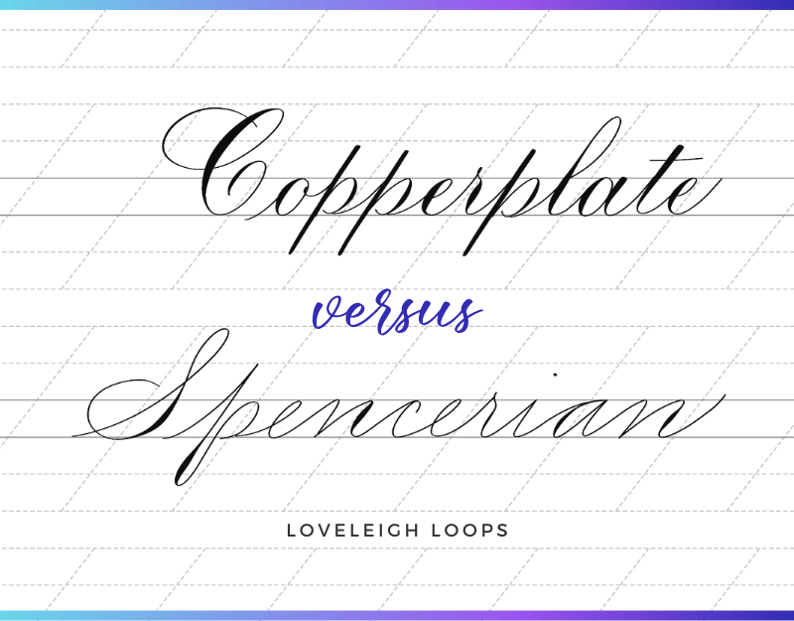
Baroque era
Copperplate script
The most used script during the 17th and 18th century
The name copperplate comes from when writing masters would use engraved plates of copper with this script to print their work
Distinguishing features: letter curves are rounder; letter slants are increased and contrasts between heavy and fine lines were more pronounced
Spencerian Script (also known as cursive)
Originated in the United States
Became the standard writing style from 19th to 20th century until the typewriter was invented

Slide 8
Modern Uses of Western Calligraphy
Used to be used for printmaking by hand until machines made it obsolete
Now used for advertisement and custom designs for things like cards, legal documents, diplomas, etc.
Older forms of calligraphy still practiced by some as an art form

Slide 9
Roman Capitals Demonstration

Slide 10
Sources Used
https://www.theartofletters.com/blog/a-brief-look-at-some-traditional-western-calligraphy-scripts
https://www.lettering-daily.com/calligraphy-history/
http://www.bl.uk/manuscripts/FullDisplay.aspx?ref=Papyrus_745
https://www.britannica.com/topic/Beneventan-script
https://www.britannica.com/topic/minuscule
https://zillers.com/learning/spencerian-and-cooperplate/#:~:text=History%20of%20Copperplate%20Script&text=Its%20name%20comes%20from%20the,the%2016th%20century%20in%20Europe
https://www.britannica.com/topic/uncial

